Slide 1
QNAP Surveillance Solution

Slide 2
QVR 5.0 (QNAP VioStor Recording System)
QNAP NVR
QVR 5.0

Slide 3
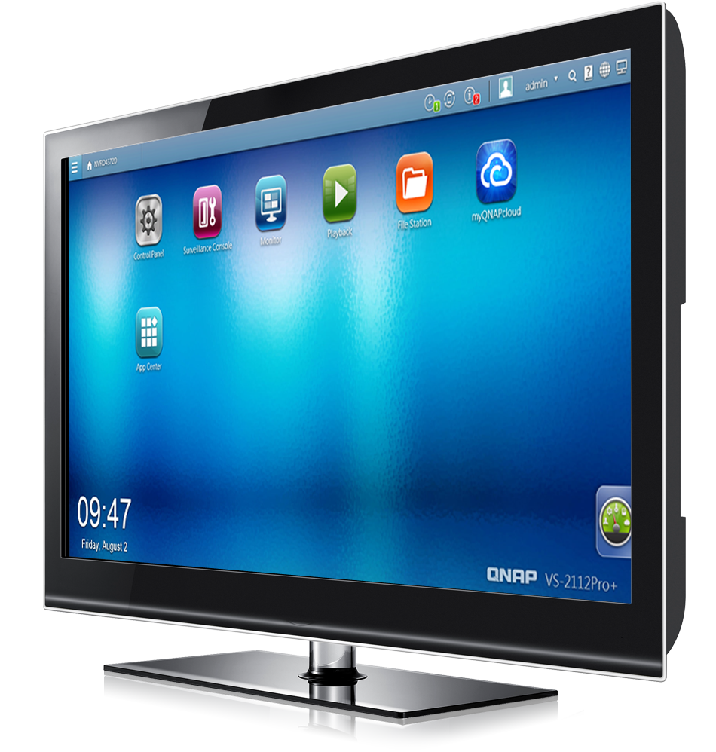
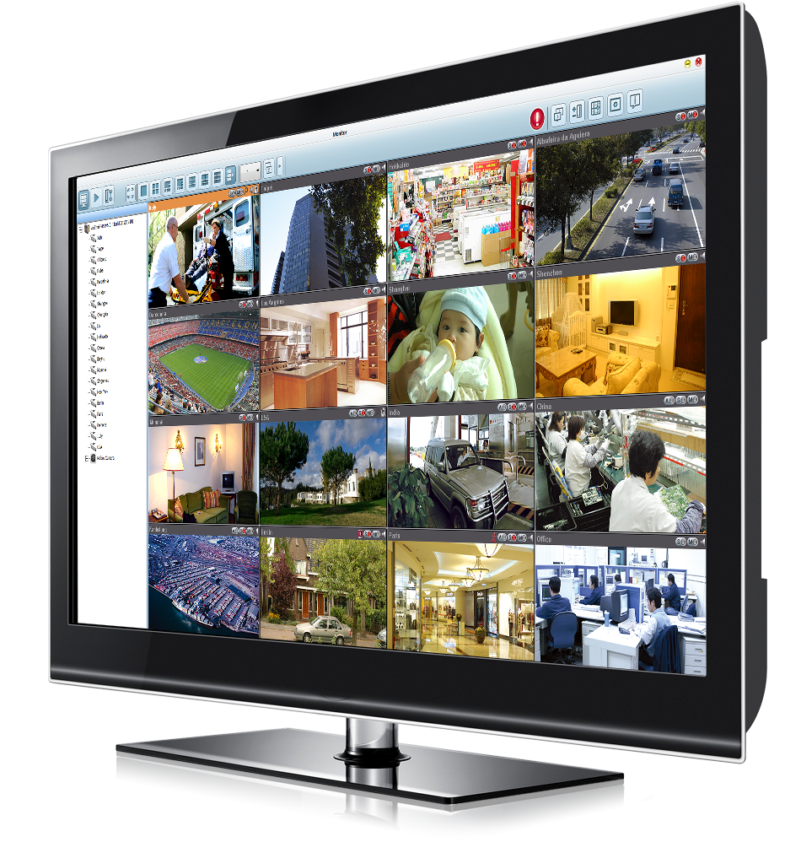
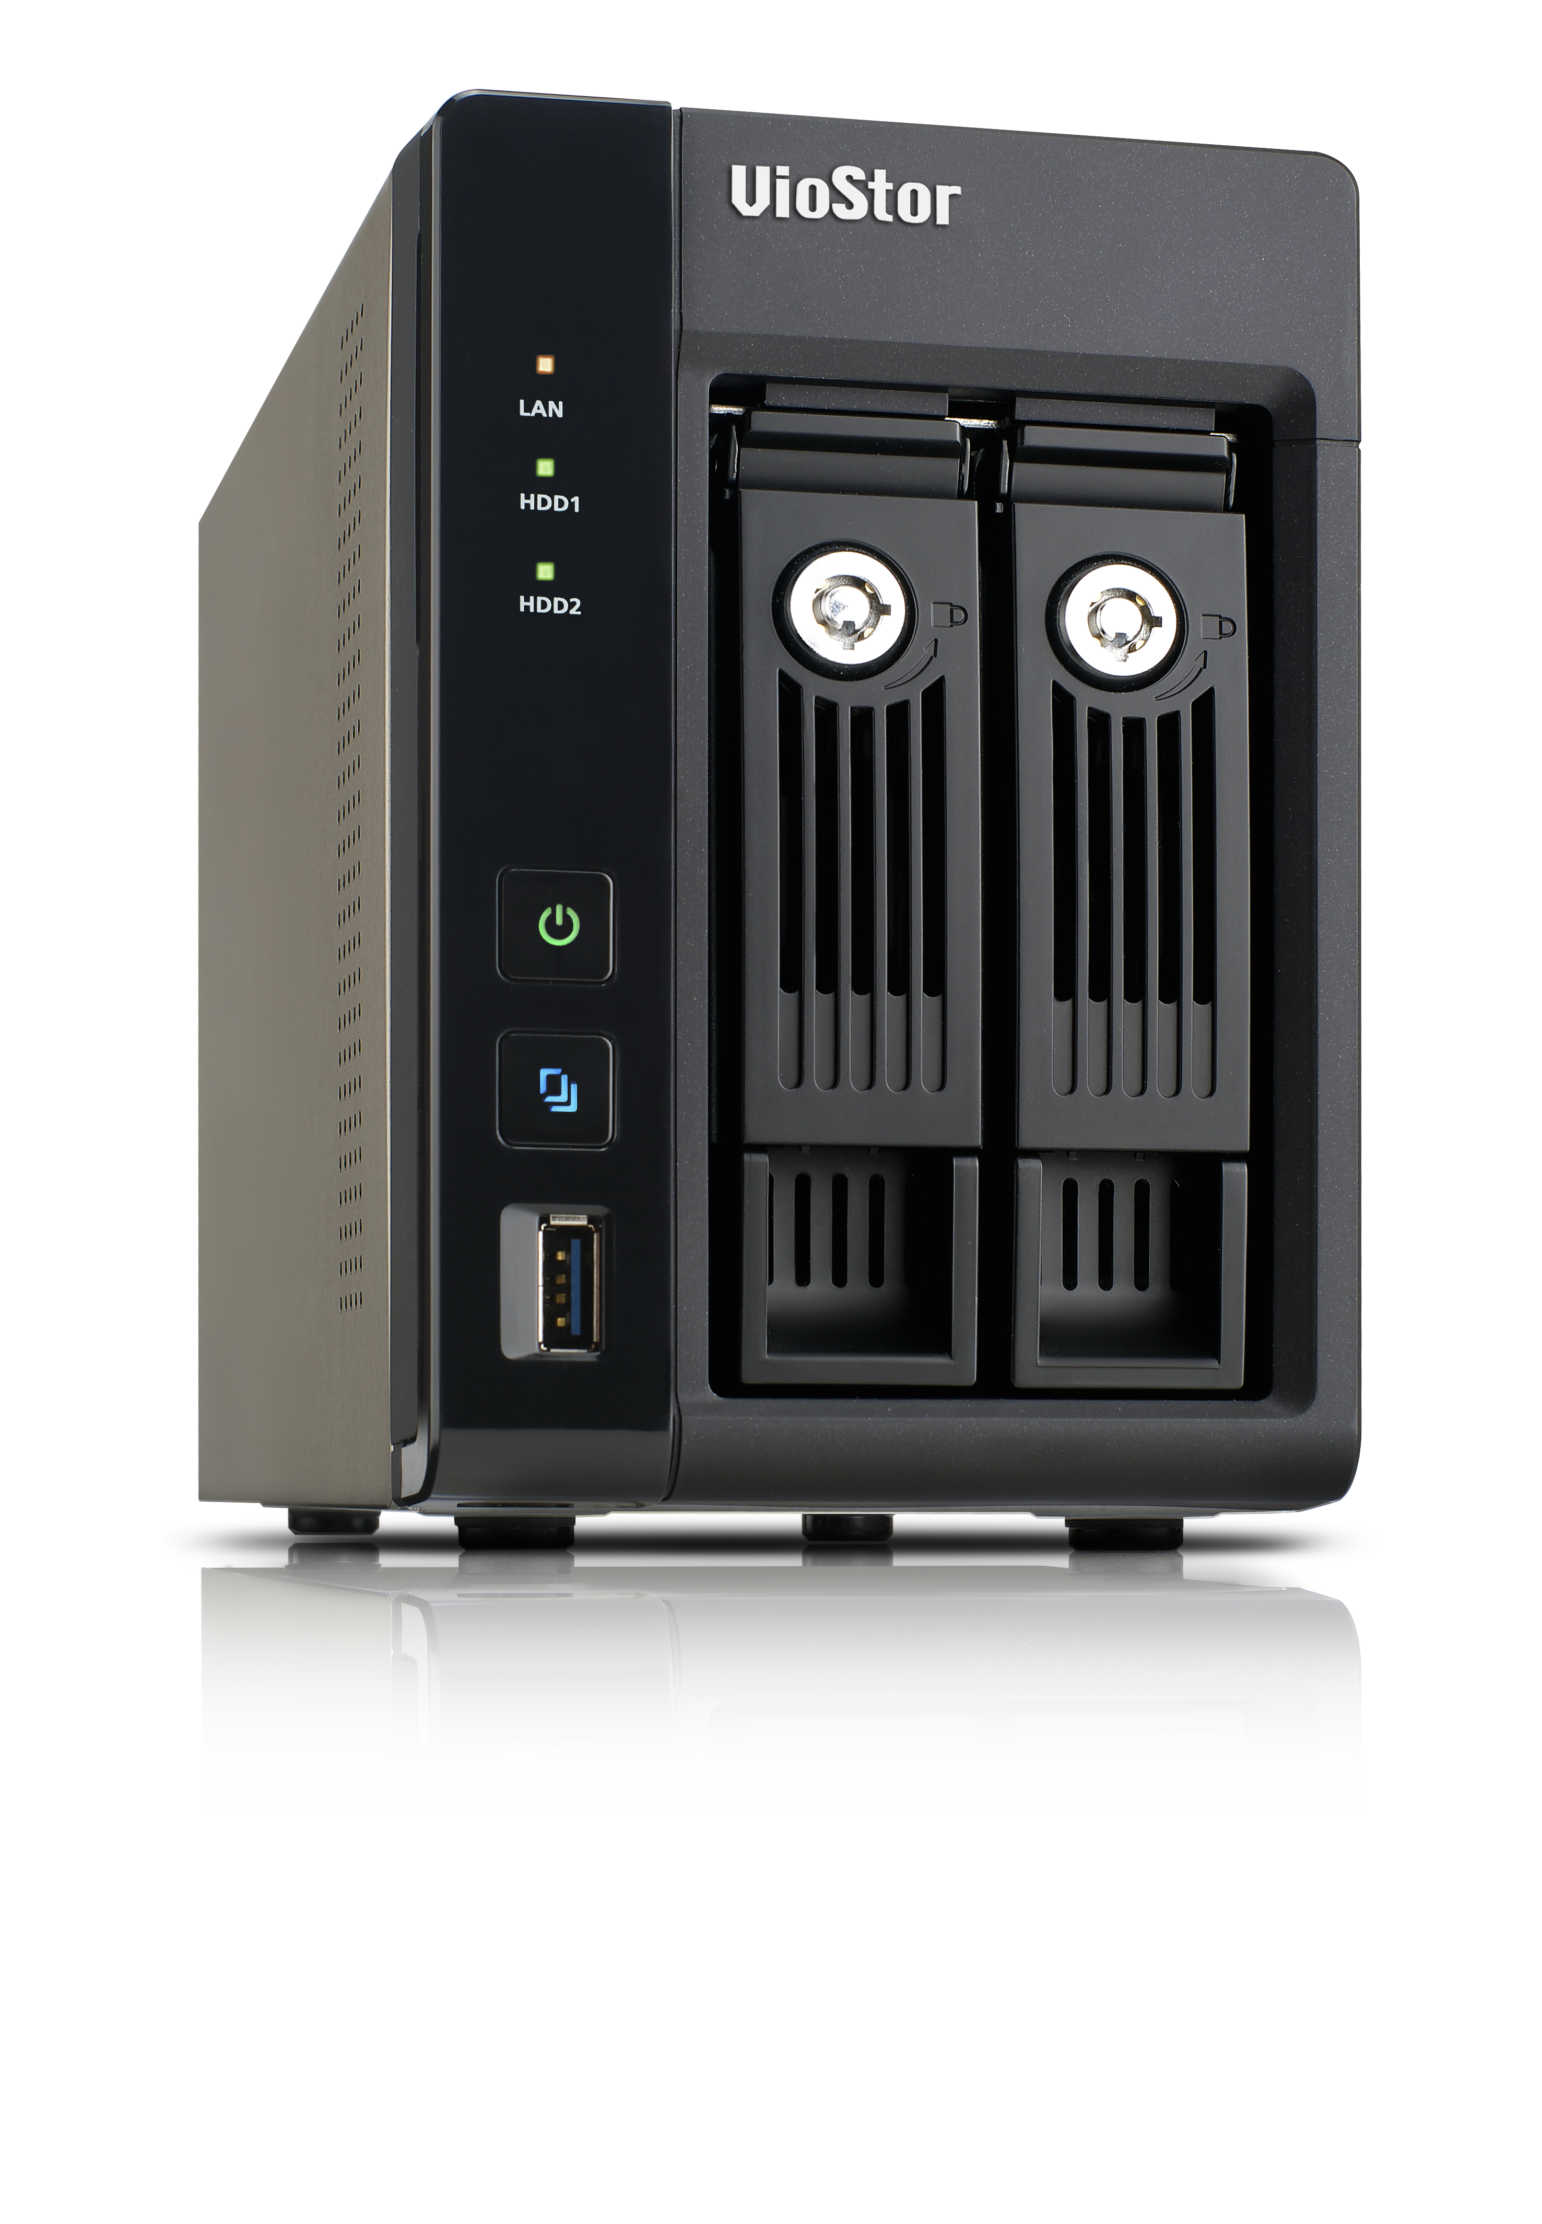
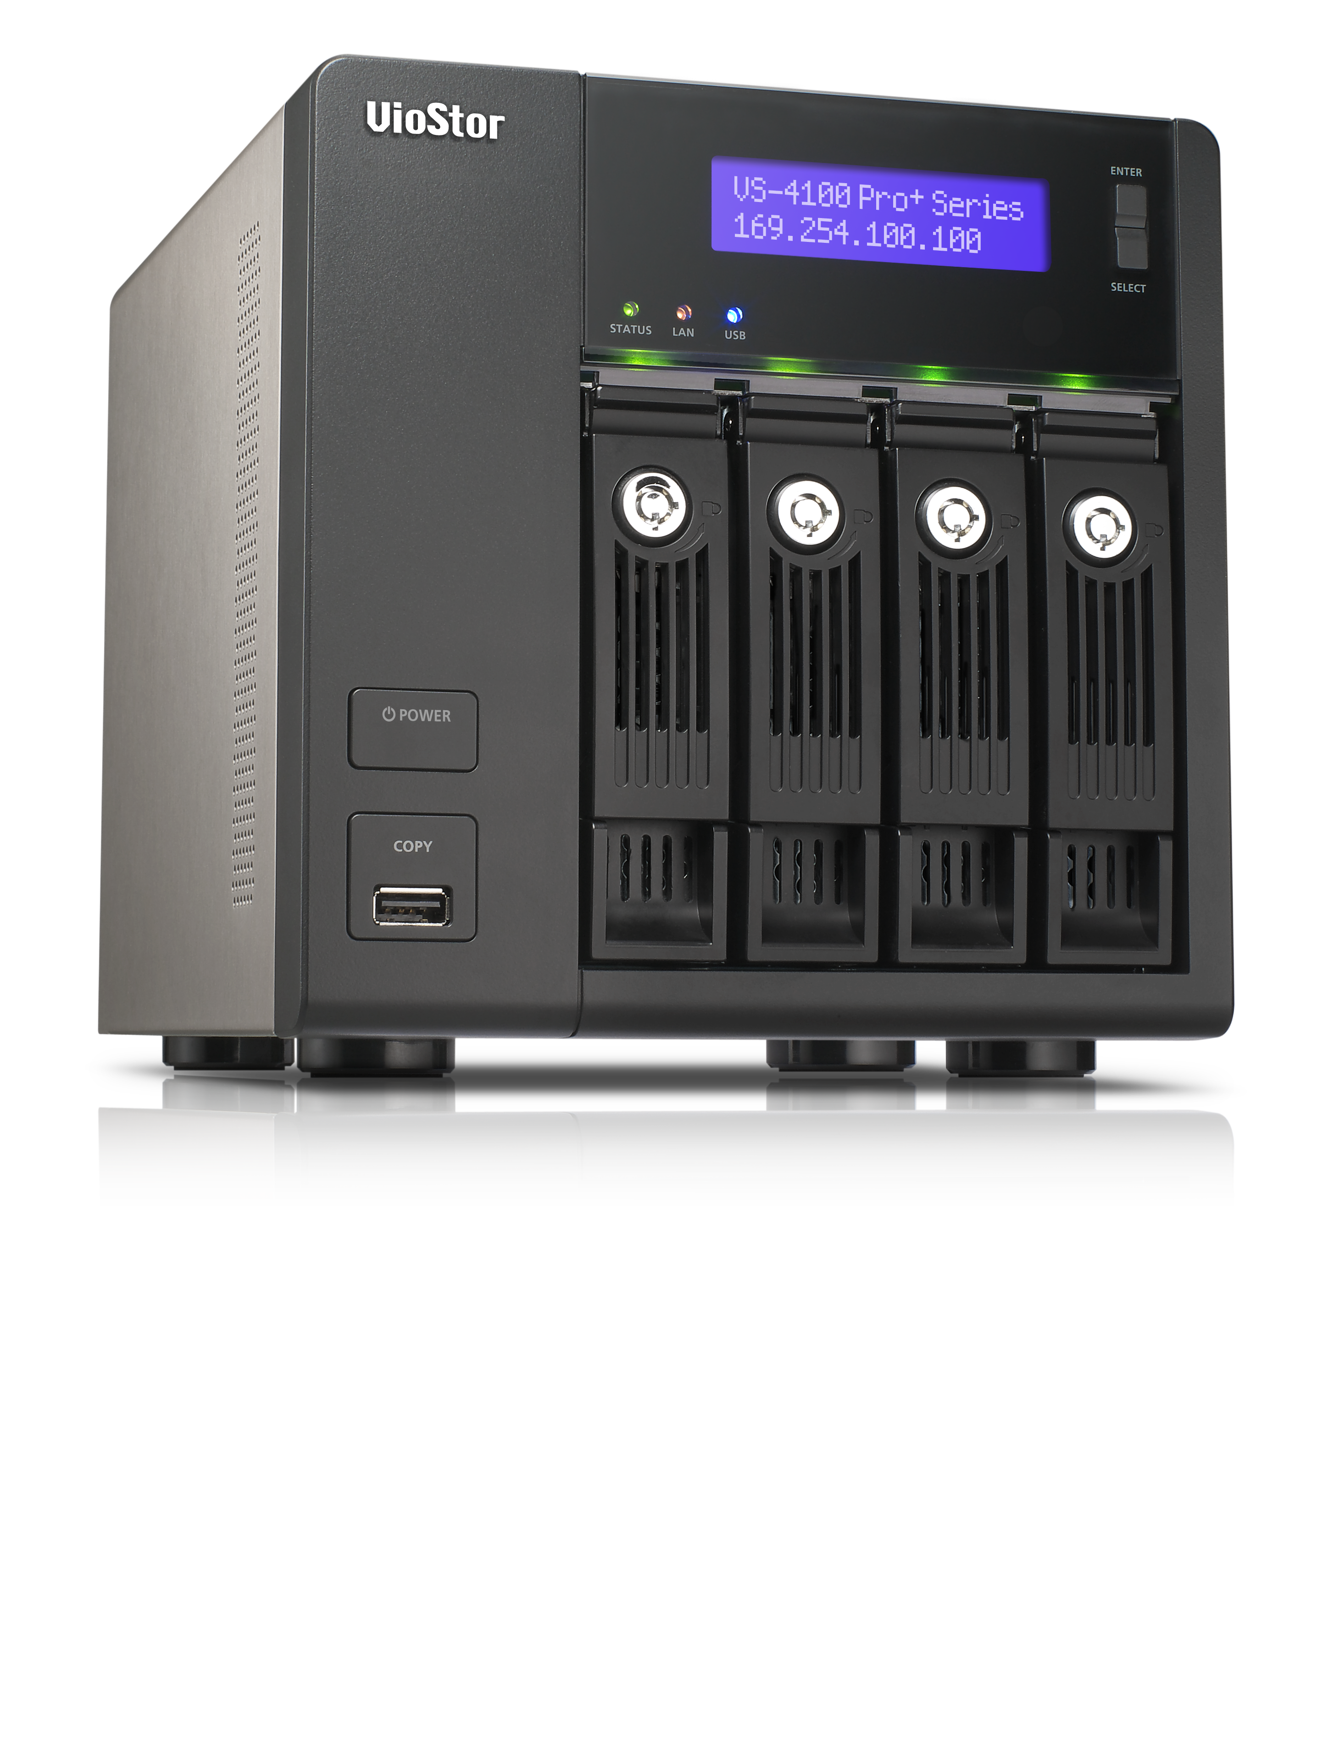
Multi-task, Multi-window
QNAP NVR
QVR 5.0
Dual display for live view and playback
Multiple tasks run on QVR desktop
Notes:
多螢幕使用 監控好方便 工作好輕鬆 免切換畫面 時時掌控現場動態

Slide 4
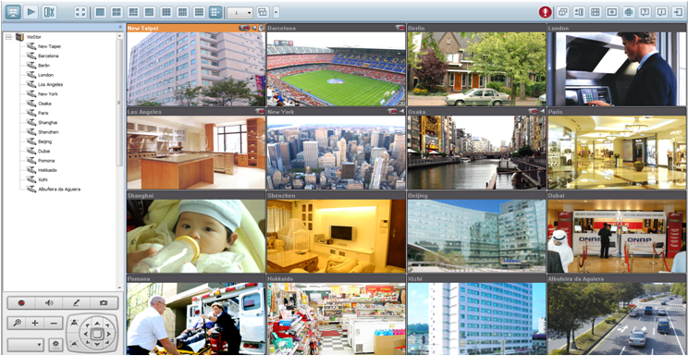
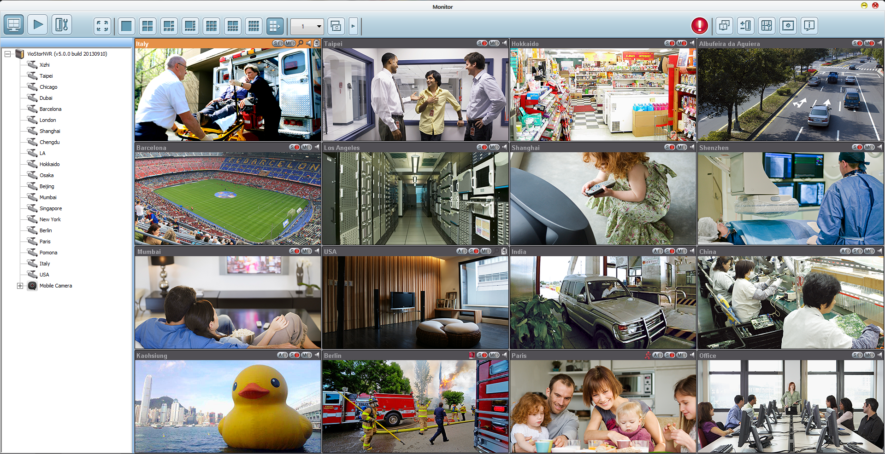
Optimized Live View Interface
QNAP NVR
QVR 5.0
Various remote monitoring modes
PTZ (Pan/Tilt/Zoom) control
Notes:
Intuitive monitoring interface
New device/camera tree for clear system overview and more features
Flexible drag & drop of control panel
提供使用者操控顯示工具列之彈性
圖有更換

Slide 5
Interactive Control Buttons
QNAP NVR
QVR 5.0
Whenever you move the mouse cursor over a camera channel, the supported function buttons of the camera will show up for quick access.
Notes:
http://patternideas.uservoice.com/forums/10238-suggest-new-design-patterns/suggestions/128913-hover-tools
浮動式工具列:
滑鼠移動至工具列範圍時，工具列浮出
提供操控便利性之同時亦兼顧畫面之簡潔

Slide 6
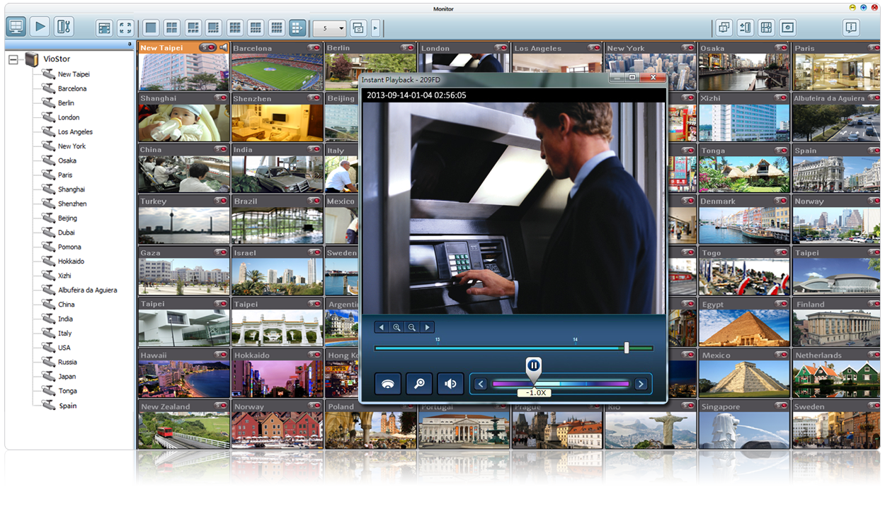
Instant Playback
QNAP NVR
QVR 5.0
Look back to check suspicious events of a camera channel you just missed
Notes:
即時錄影回放
在緊急事件發生時可調閱最近期之錄影畫面
可自訂調閱之錄影檔案區間

Slide 7
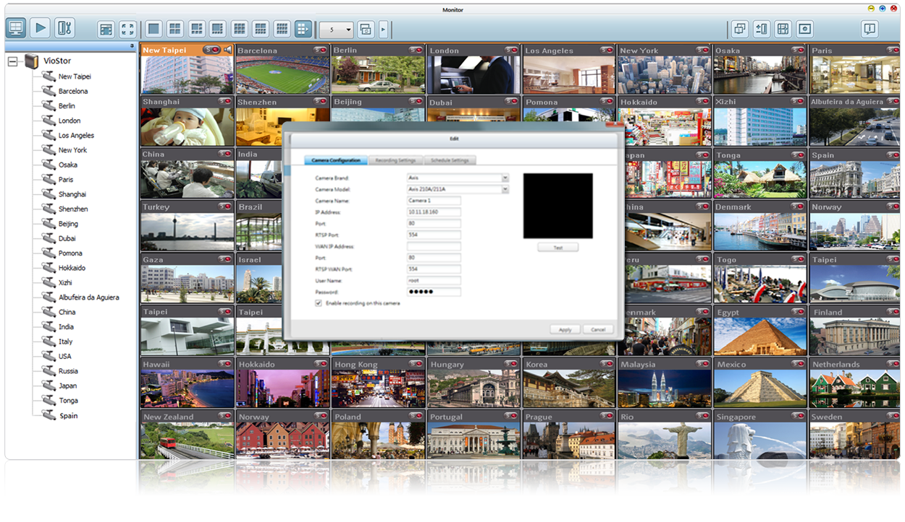
Same-screen IP Camera Configurations
QNAP NVR
QVR 5.0
Configure IP camera recording schedules when needed without leaving the Live-view page, maintaining a seamless monitoring so you won’t miss any suspicious event.
Notes:
在即時畫面監看頁面可直接做攝影機設定，毋須切換至系統管理頁面

Slide 8
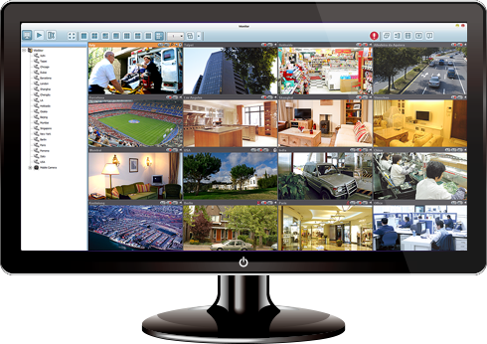
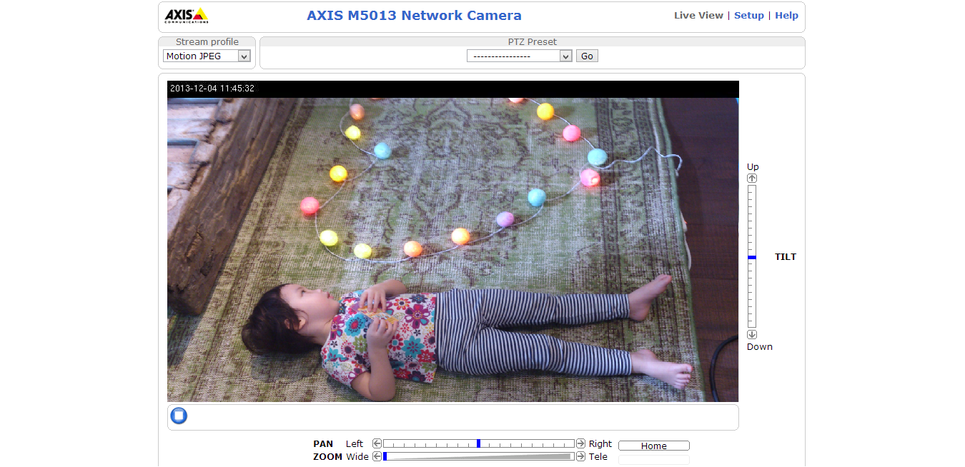
Remote IP Cam Management
QNAP NVR
QVR 5.0
Internet
LAN

Slide 9
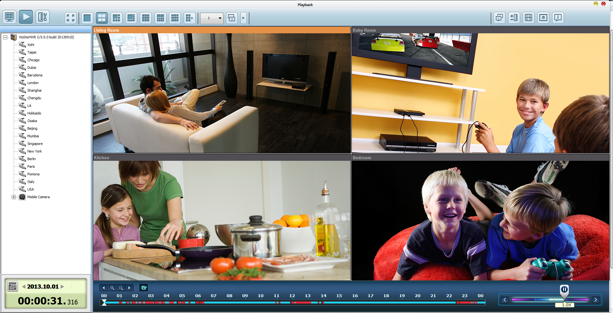
Intuitive Playback Interface
QNAP NVR
QVR 5.0
Playback and speed control by shuttle bar
Identify events easily
Notes:
圖有更換

Slide 10
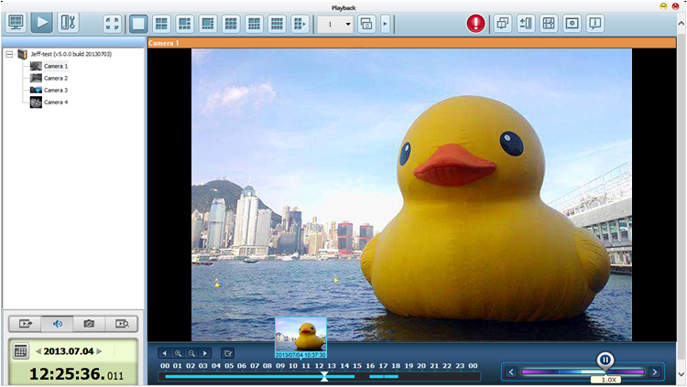
Preview Recordings by Thumbnails
QNAP NVR
QVR 5.0
You can move the mouse cursor over the timeline to preview the video thumbnails to quickly identify and search the event.
Notes:
即時預覽
當滑鼠在時間軸上移動時，會同時顯示即時預覽畫面，方便使用者更精確的找到錄影畫面的時間點
沒陰影

Slide 11
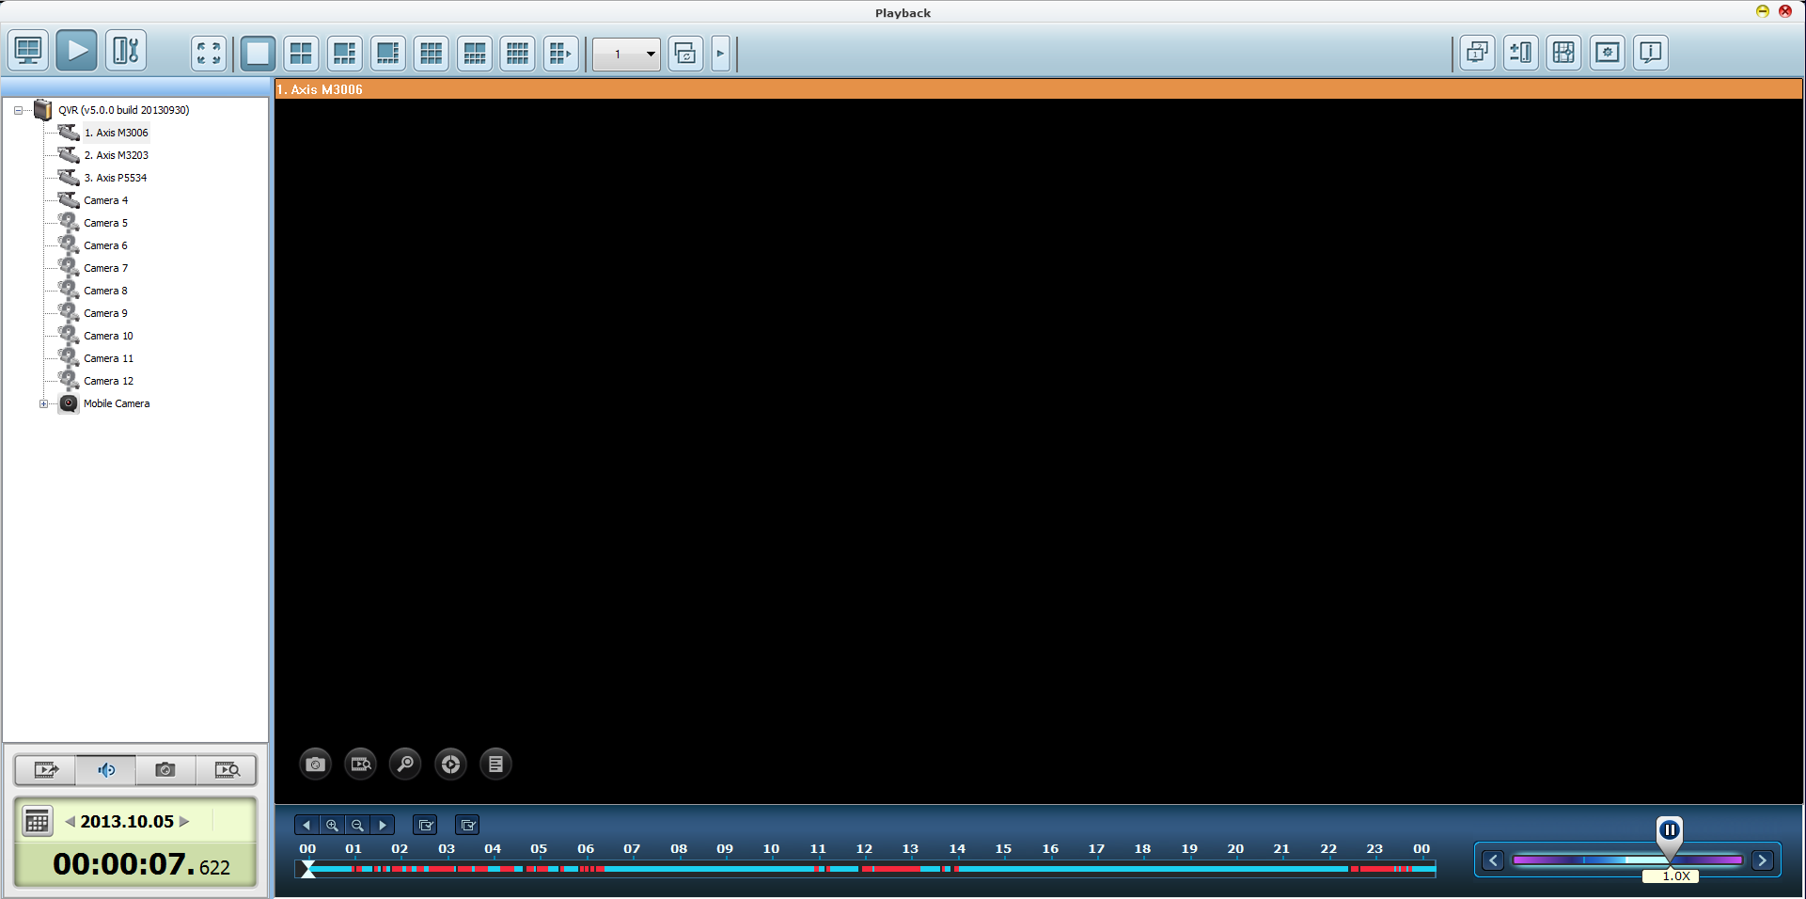
Zoom in to See Details
QNAP NVR
QVR 5.0
By right-clicking the mouse and dragging an area on the screen, that area will be enlarged with a more clear view.
Notes:
11
回放畫面縮放控制
滑鼠左鍵框選選取特定區域作縮放
滑鼠滾輪滑動作縮放控制

Slide 12
Extract Video for Export
QNAP NVR
QVR 5.0
Upload to YouTube
Save to client PC
Notes:
美化
擷取錄影畫面輸出
擷取錄影畫面:
轉存至本地端
上傳至Youtube
email傳送分享

Slide 13
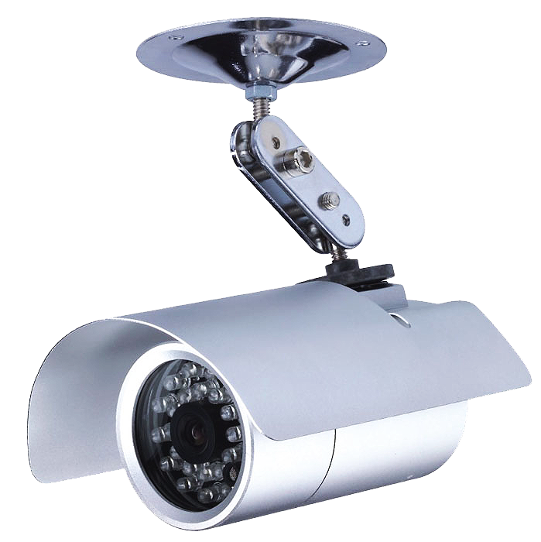
Select Recording Mode
QNAP NVR
QVR 5.0
Basic
Pro
Standard Recording
(System Configured)
Smart Recording (User Defined)
Notes:
美化

Slide 14
Smart Recording
QNAP NVR
QVR 5.0
Smart recording intelligently records standard resolution videos in regular recording, and switches to high resolution automatically when alarms are triggered. This greatly saves your cost spent on hard drives and provides you with high resolution video evidence when needed.
Low resolution video stream
High resolution video stream
Notes:
美化，用影像圖

Slide 15
Support Global Camera Brands
QNAP NVR
QVR 5.0
High quality recording
Smart recording
Notes:
Schedule for other camera brand and models

Slide 16
Mobile App

Slide 17
Vcam Turn your mobile cam as IP camera
Record to NAS/NVR
Notes:
手機和電腦圖用相同的錄像

Slide 18
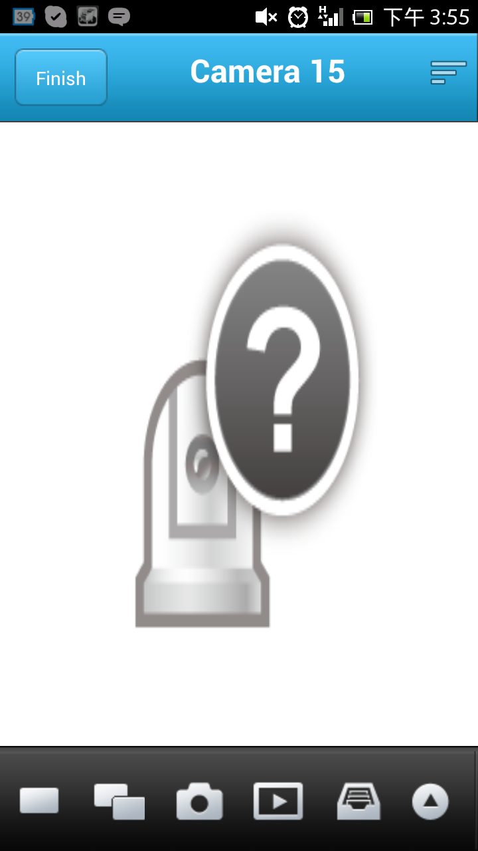
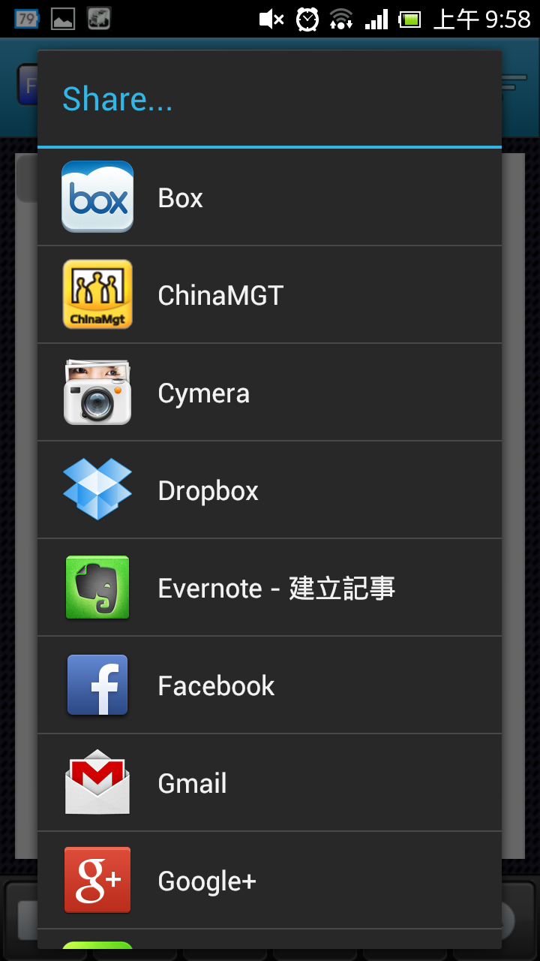
VMobile Mobile Surveillance
Live view, event notification, playback and instant sharing of snapshots

