Slide 1
QNAP Surveillance Solution

Slide 2
QNAP Security Roadmap

Slide 3
QNAP NVR Features Roadmap
V5.1.0
V5.0.0
(Apr 2014)
(Jan 2014)
View edit, camera group,
camera multiple view, fisheye enhancement, instant playback enhancement, storage expansion support on expansion units, MCLDC, one-click installation
Desktop-like user interface, interactive control buttons, instant playback, same-screen IP camera configurations, playback and speed control by shuttle bar, license upgrade, myQNAPcloud, App center
V4.1.1
NVR
(Sep 2013)
Future
Surveillance storage expansion, user defined multi-stream, smart recording, edge recording
Hardware decode on Windows Client, dual recording, Cloud NVR (non-stop recording, fault-tolerance), mass storage support, flexible channel assignment, Mobotix enhancement
Vcam: Turn your mobile phone as IP camera
Vcam + edge recording
Real-time IVA
App
Beta
Keep updating…
NVR fail over
Nov
Dec
Jan
Feb
Mar
Apr
May
Jun
2014
Q4,2013
Q1, 2014
Q2,2014

Slide 4
QNAP NVR Product Roadmap
VS- 16200U-RP Pro+
( Q2. 2014)
ENTERPRISE
VS- 12100U-RP Pro+
450
Mbps
VS- 12200U-RP Pro+
( TBD)
VS- 8100U-RP Pro+
400
Mbps
VS- 8200U-RP Pro+
( TBD)
VS- 8100 Pro+
400
Mbps
VS- 8200 Pro+
( Feb. 2014)
VS- 6100 Pro+
330 Mbps
VS- 4100U-RP Pro+
250
Mbps
SMB/ SOHO
VS- 4100 Pro+
250 Mbps
VS- 2100 Pro+
180
Mbps
VS- 2000 Pro+
( Mar. 2014)
Intel Haswell processor, 4/8GB DDR3 RAM
VS- 2100L
40 Mbps
Intel Core i5 processor 3.7GHz, 8GB DDR3 RAM
VS-2200L
Intel Core i3 processor 3.3GHz, 4GB DDR3 RAM
( TBD)
HOME
Intel Atom processor 1.91GHz, 2GB DDR3 RAM
Intel Celeron processor 2.7GHz, 4GB DDR3 RAM
Marvell 1.6 GHz processor, 512MB DDR3 RAM
Marvell Processor
Nov
Dec
Jan
Feb
Mar
Apr
May
Jun
2014
Q4,2013
Q1, 2014
Q2,2014

Slide 5
Industrial Grade NVR Product Roadmap
Outdoor
VS-M4000 /
VS-M4000 Pro+
(Q2. 2014)
Intel Mobile processor dual-core1.1GHz,2GB DDR3 RAM
Nov
Dec
Jan
Feb
Mar
Apr
May
Jun
2014
Q4,2013
Q1, 2014
Q2,2014

Slide 6
QVR 5.0
QNAP NVR
QVR 5.0
QNAP VioStor Recording System

Slide 7
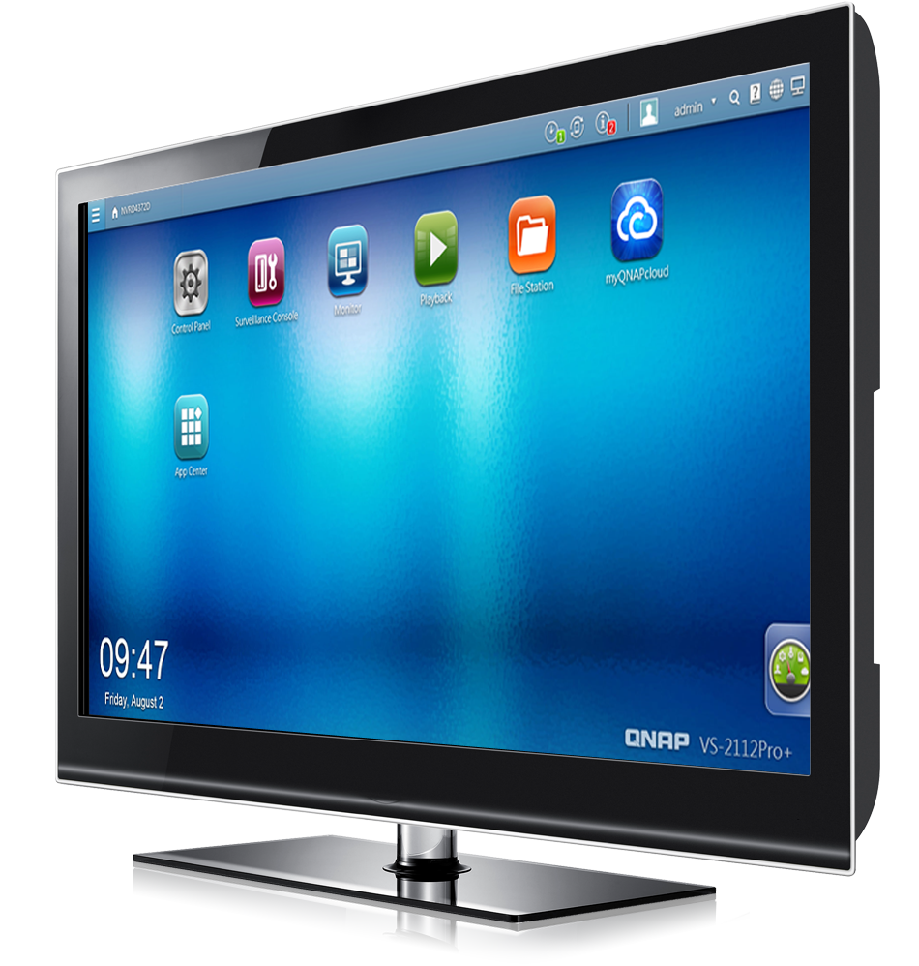
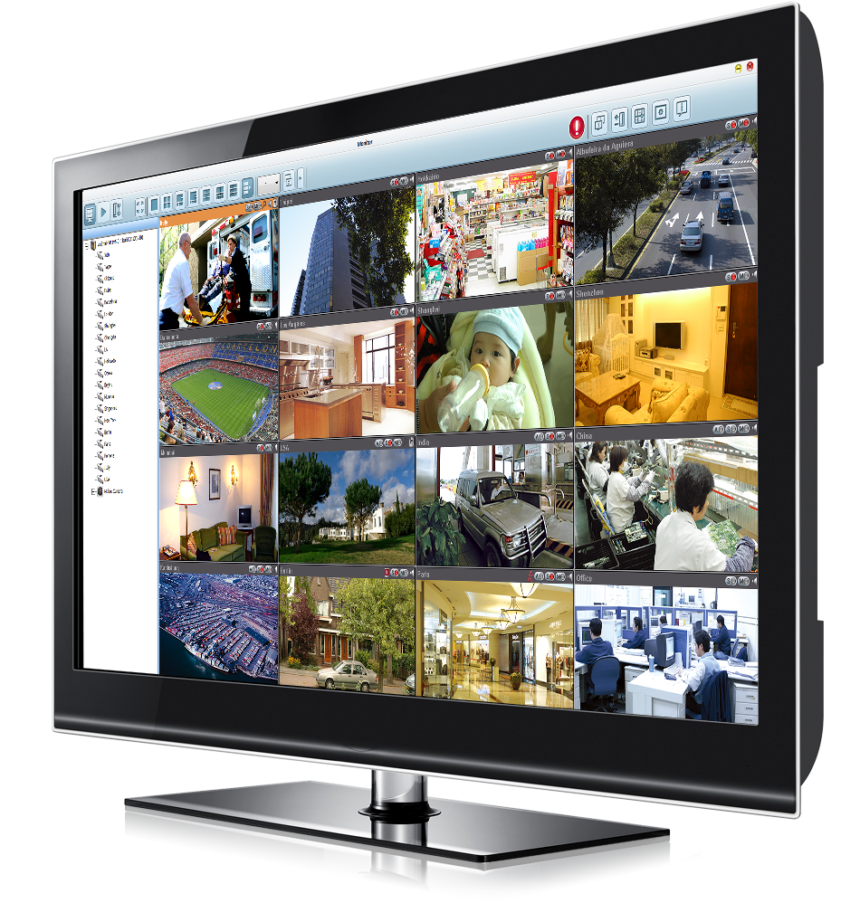
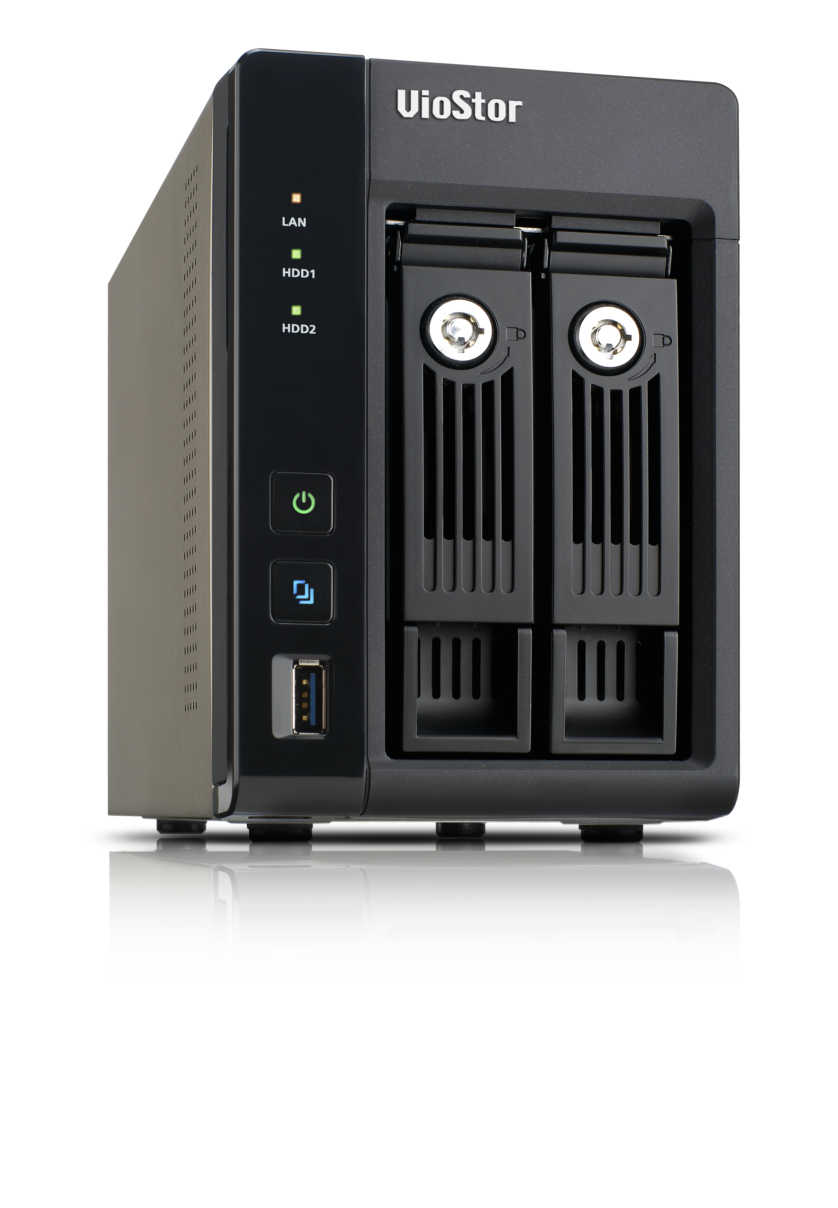
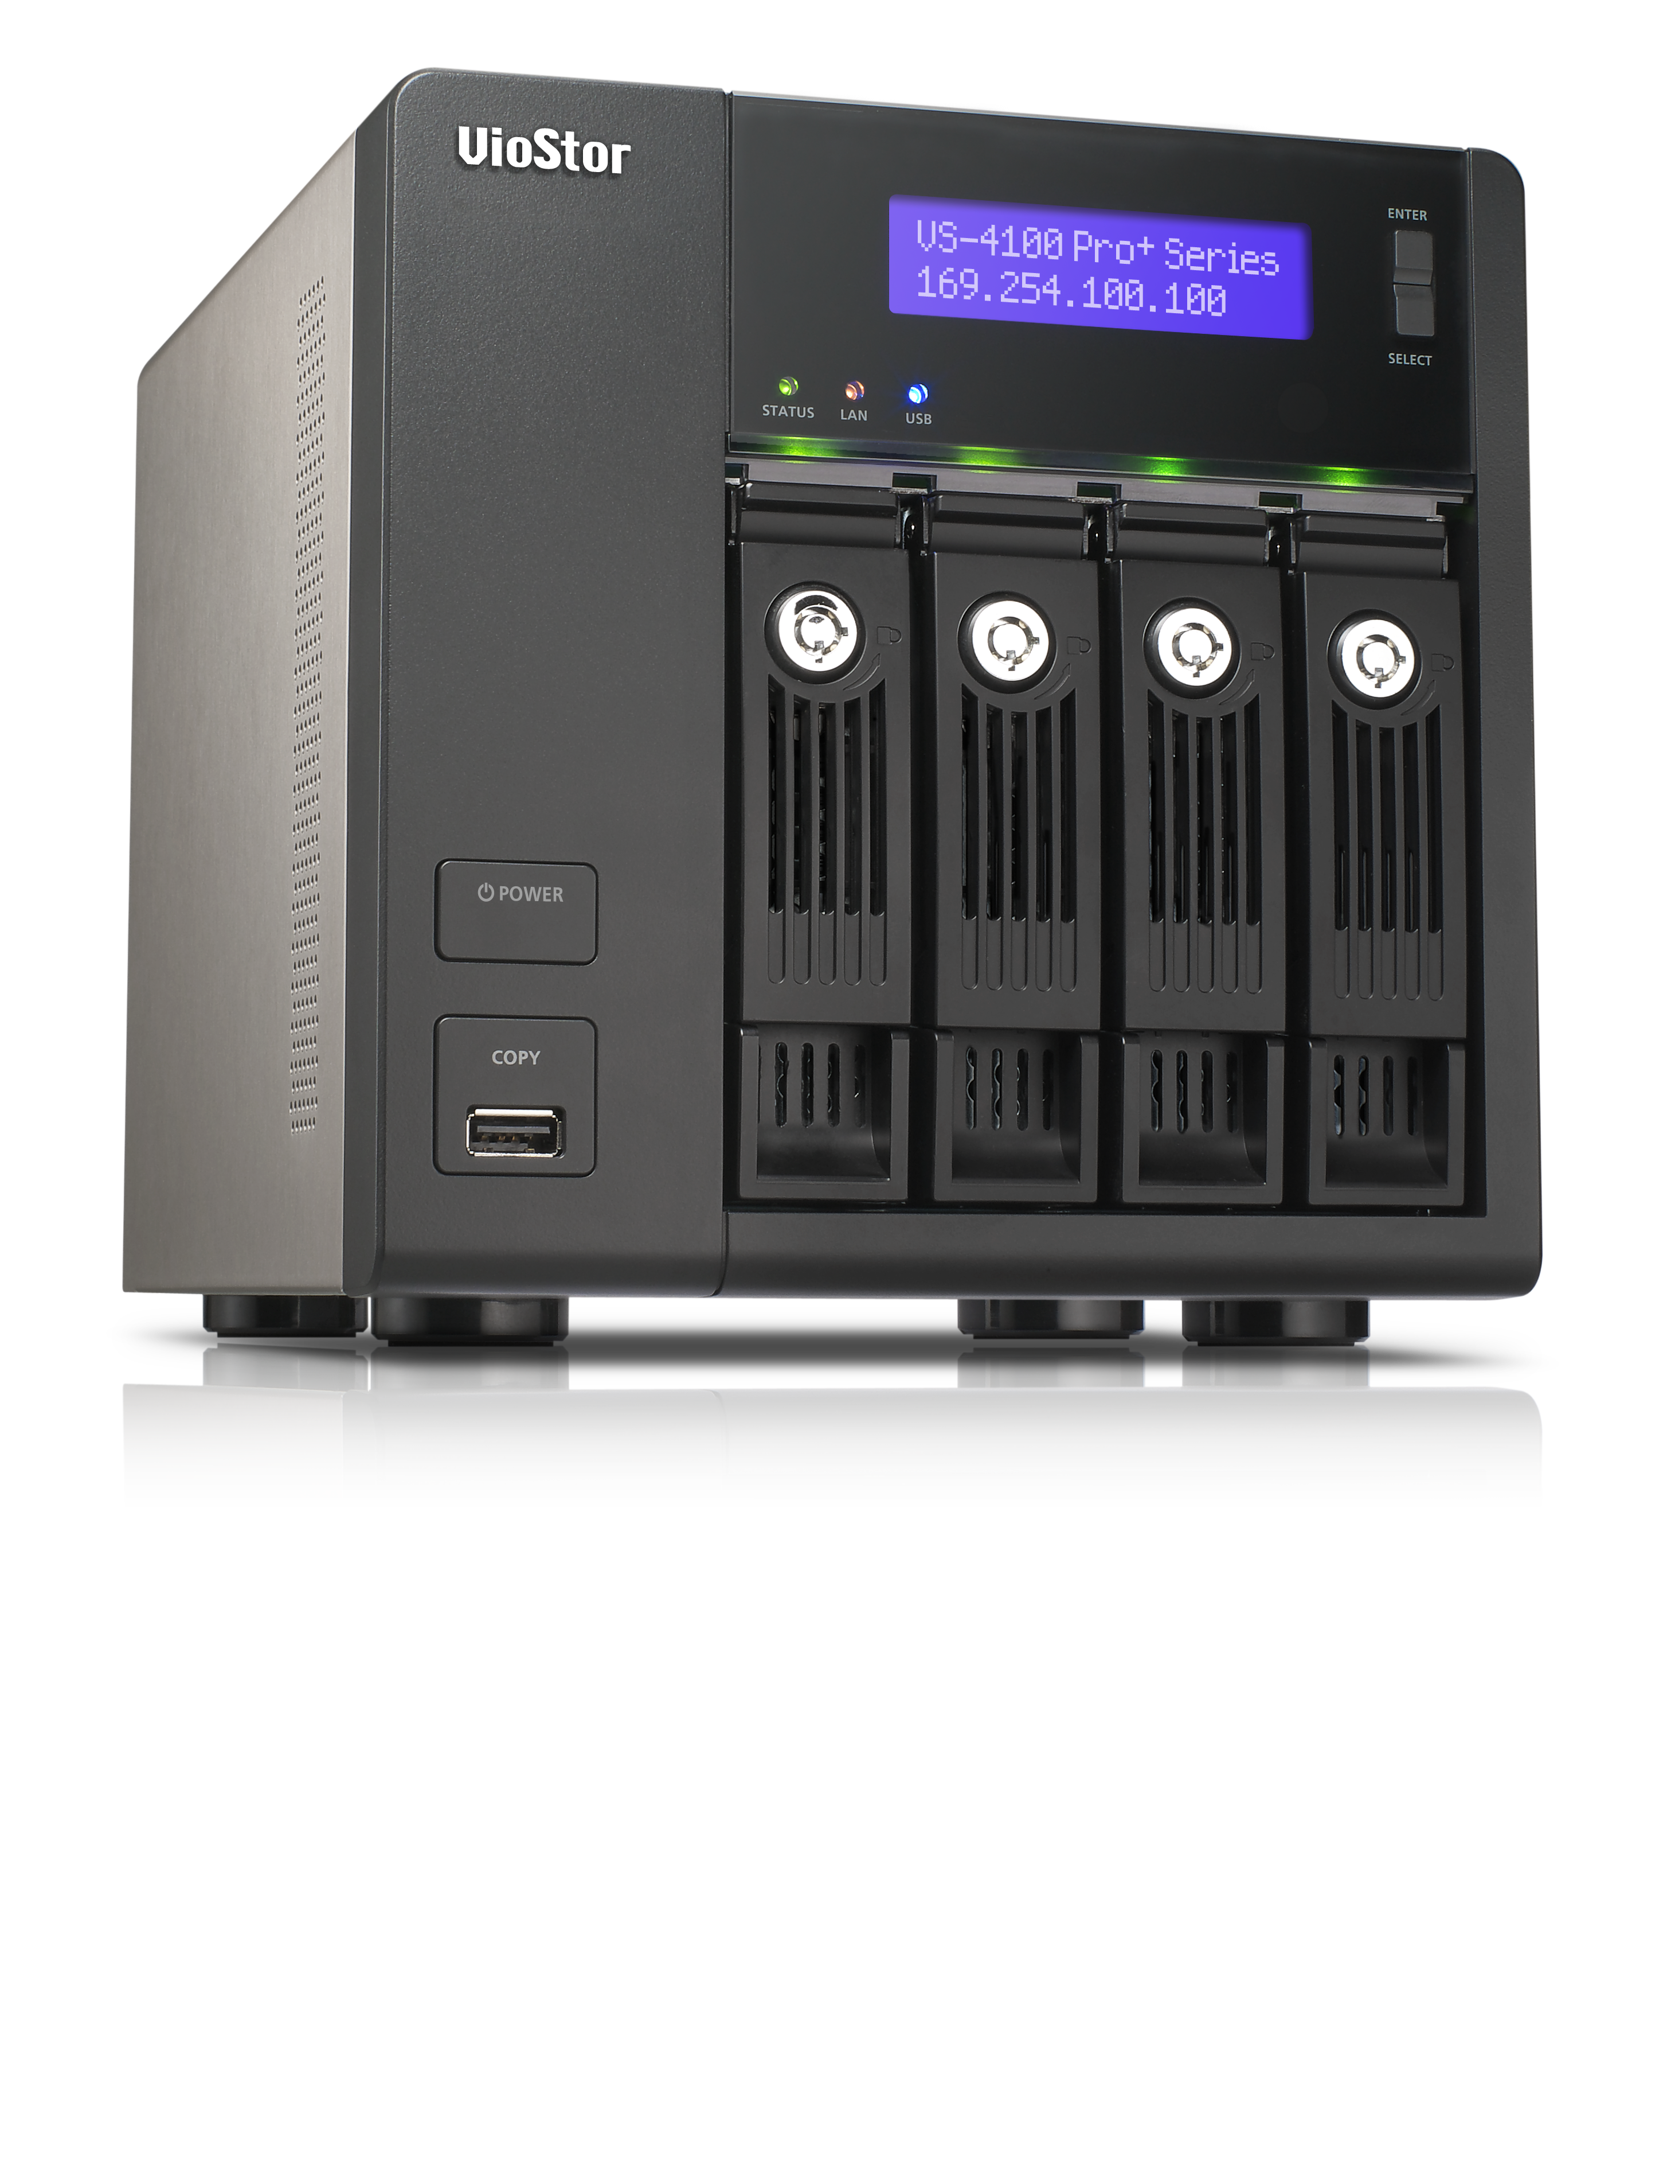
Multi-task, Multi-window
QNAP NVR
QVR 5.0
Dual display for live view and playback
Multiple tasks run on QVR desktop
Notes:
多螢幕使用 監控好方便 工作好輕鬆 免切換畫面 時時掌控現場動態

Slide 8
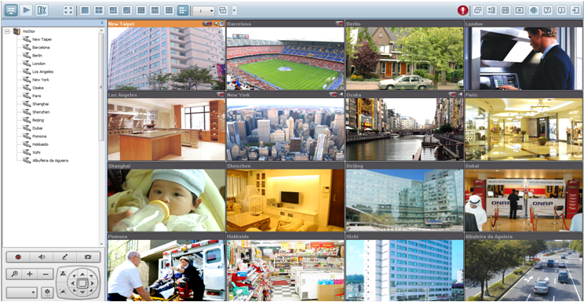
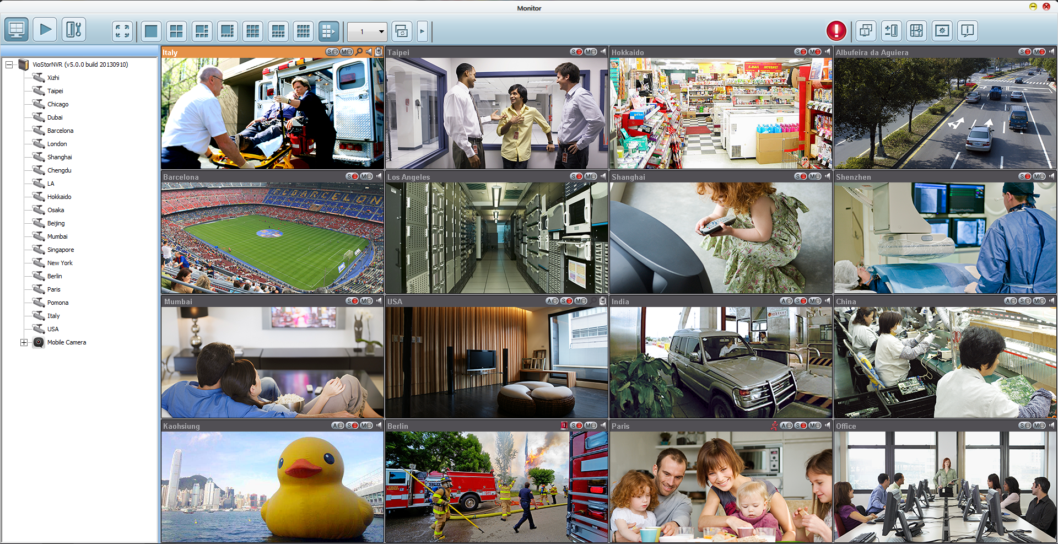
Optimized Live View Interface
QNAP NVR
QVR 5.0
Various remote monitoring modes
PTZ (Pan/Tilt/Zoom) control
Notes:
Intuitive monitoring interface
New device/camera tree for clear system overview and more features
Flexible drag & drop of control panel
提供使用者操控顯示工具列之彈性
圖有更換

Slide 9
Interactive Control Buttons
QNAP NVR
QVR 5.0
Whenever you move the mouse cursor over a camera channel, the supported function buttons of the camera will show up for quick access.
Notes:
http://patternideas.uservoice.com/forums/10238-suggest-new-design-patterns/suggestions/128913-hover-tools
浮動式工具列:
滑鼠移動至工具列範圍時，工具列浮出
提供操控便利性之同時亦兼顧畫面之簡潔

Slide 10
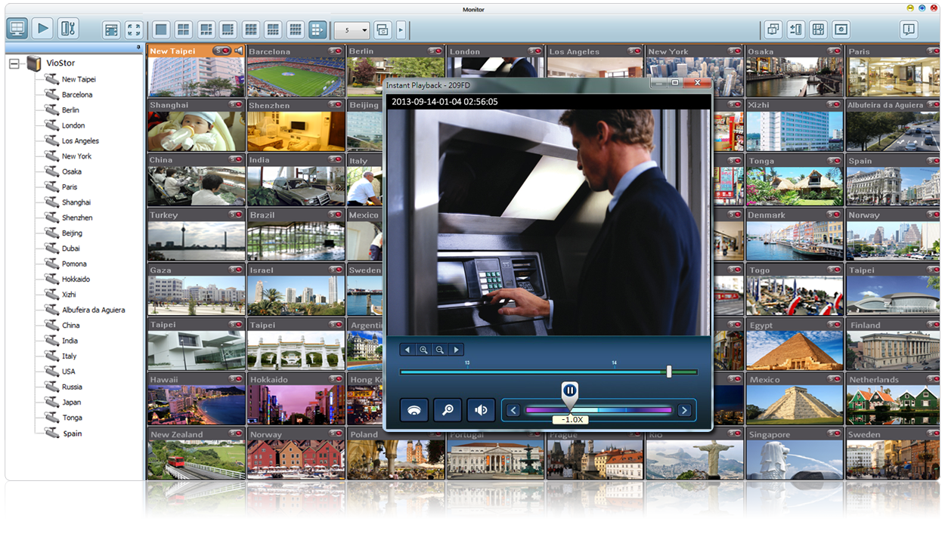
Instant Playback
QNAP NVR
QVR 5.0
Look back to check suspicious events of a camera channel you just missed
Notes:
即時錄影回放
在緊急事件發生時可調閱最近期之錄影畫面
可自訂調閱之錄影檔案區間

Slide 11
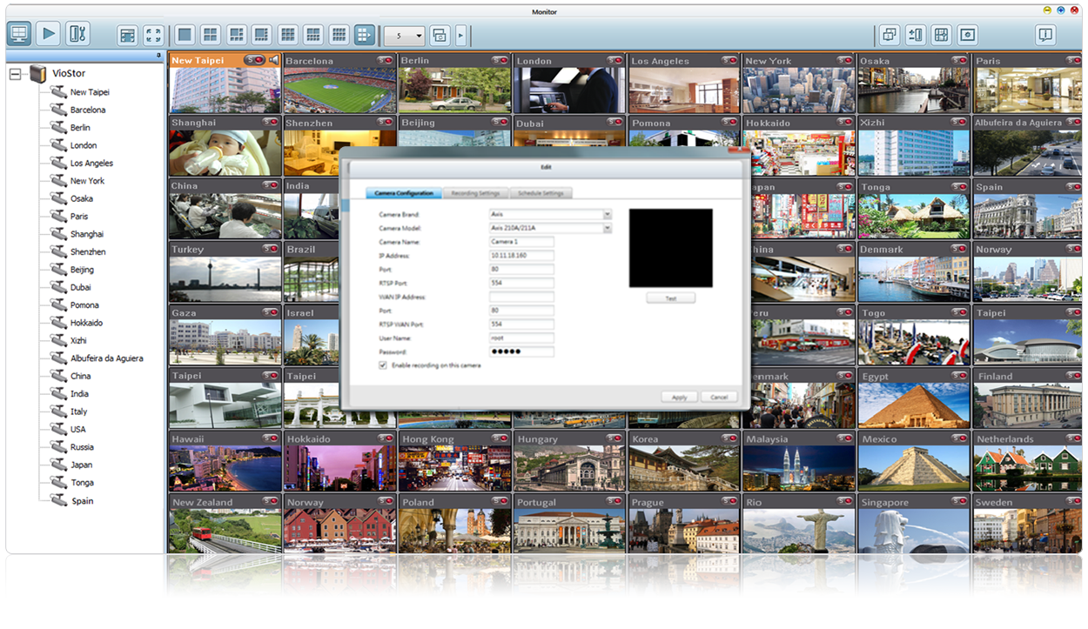
Same-screen IP Camera Configurations
QNAP NVR
QVR 5.0
Configure IP camera recording schedules when needed without leaving the Live-view page, maintaining a seamless monitoring so you won’t miss any suspicious event.
Notes:
在即時畫面監看頁面可直接做攝影機設定，毋須切換至系統管理頁面

Slide 12
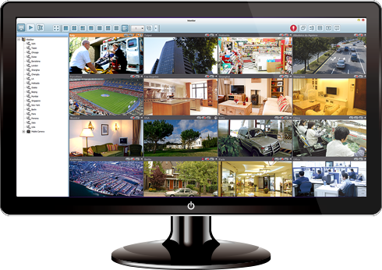
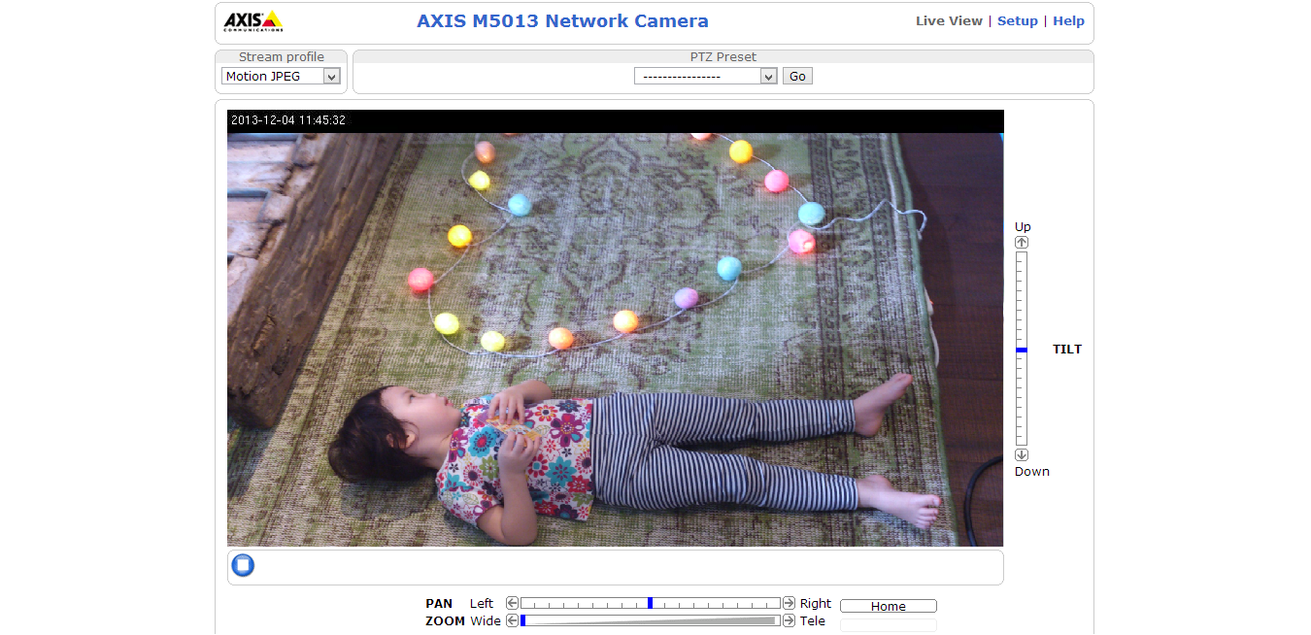
Remote IP Cam Management
QNAP NVR
QVR 5.0
Internet
LAN

Slide 13
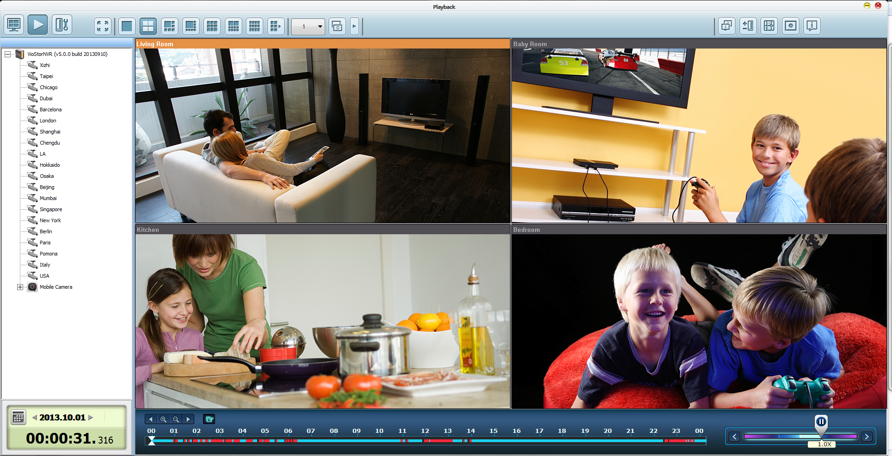
Intuitive Playback Interface
QNAP NVR
QVR 5.0
Playback and speed control by shuttle bar
Identify events easily
Notes:
圖有更換

Slide 14
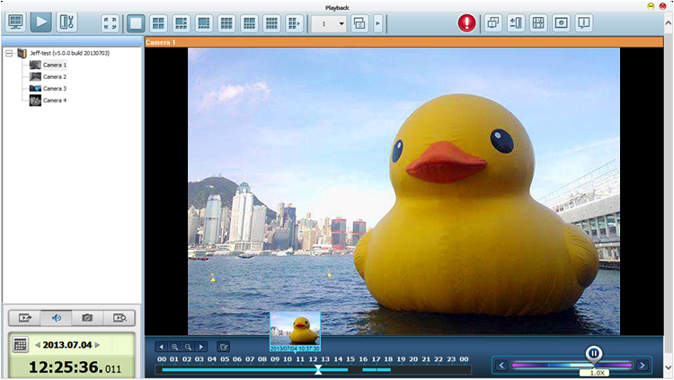
Preview Recordings by Thumbnails
QNAP NVR
QVR 5.0
You can move the mouse cursor over the timeline to preview the video thumbnails to quickly identify and search the event.
Notes:
即時預覽
當滑鼠在時間軸上移動時，會同時顯示即時預覽畫面，方便使用者更精確的找到錄影畫面的時間點
沒陰影

Slide 15
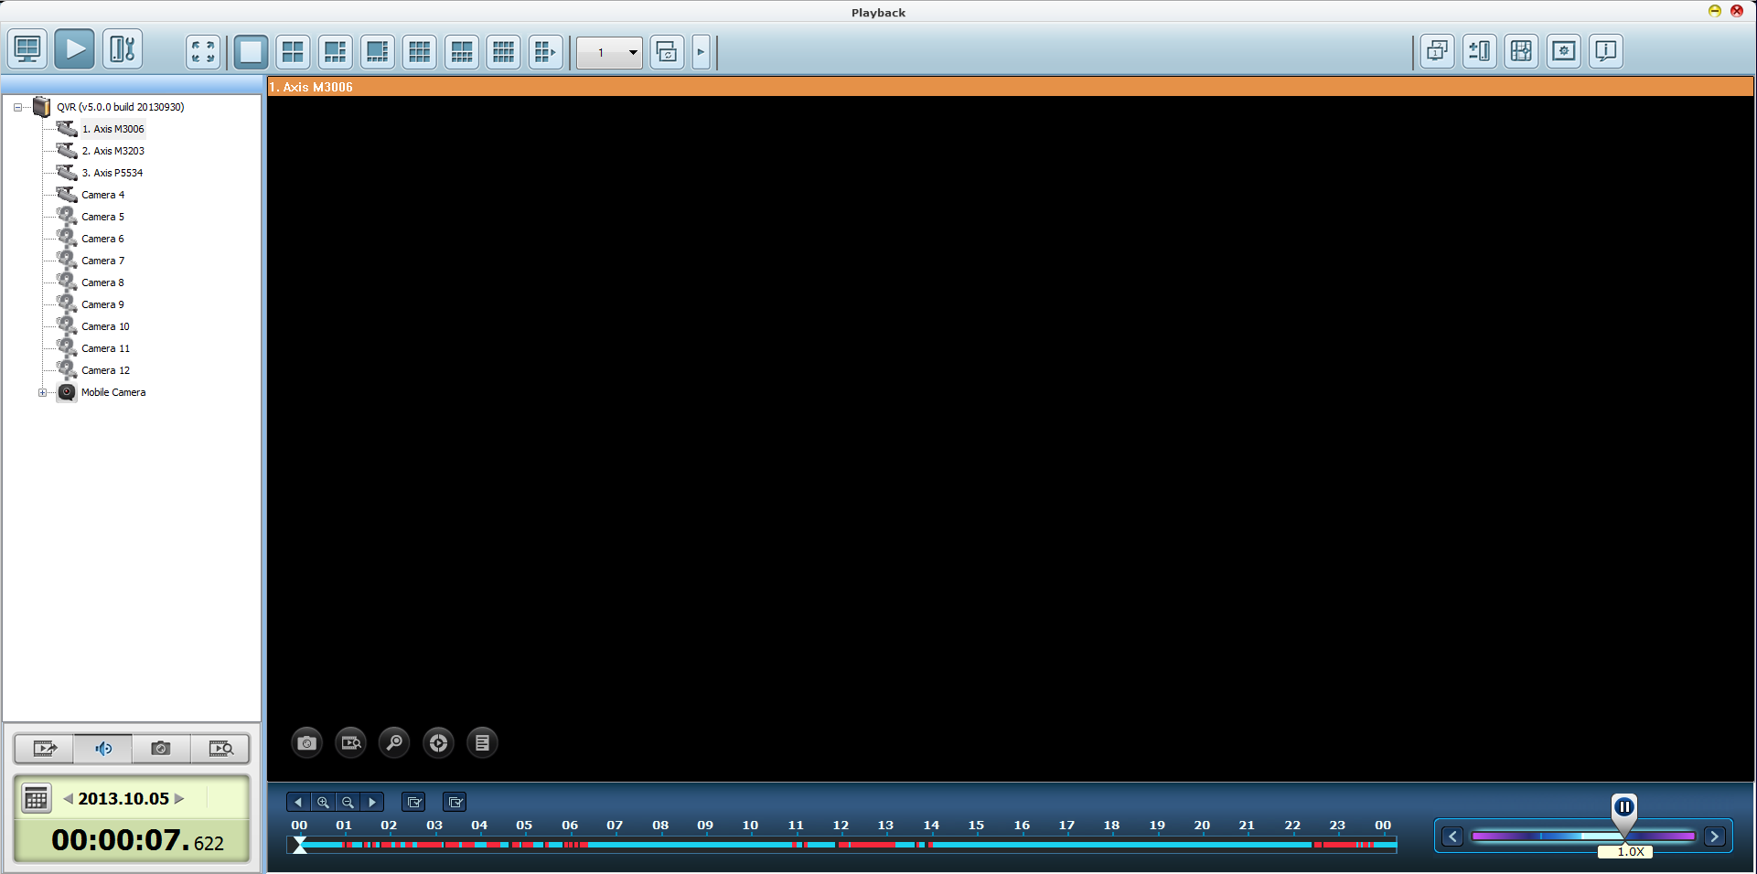
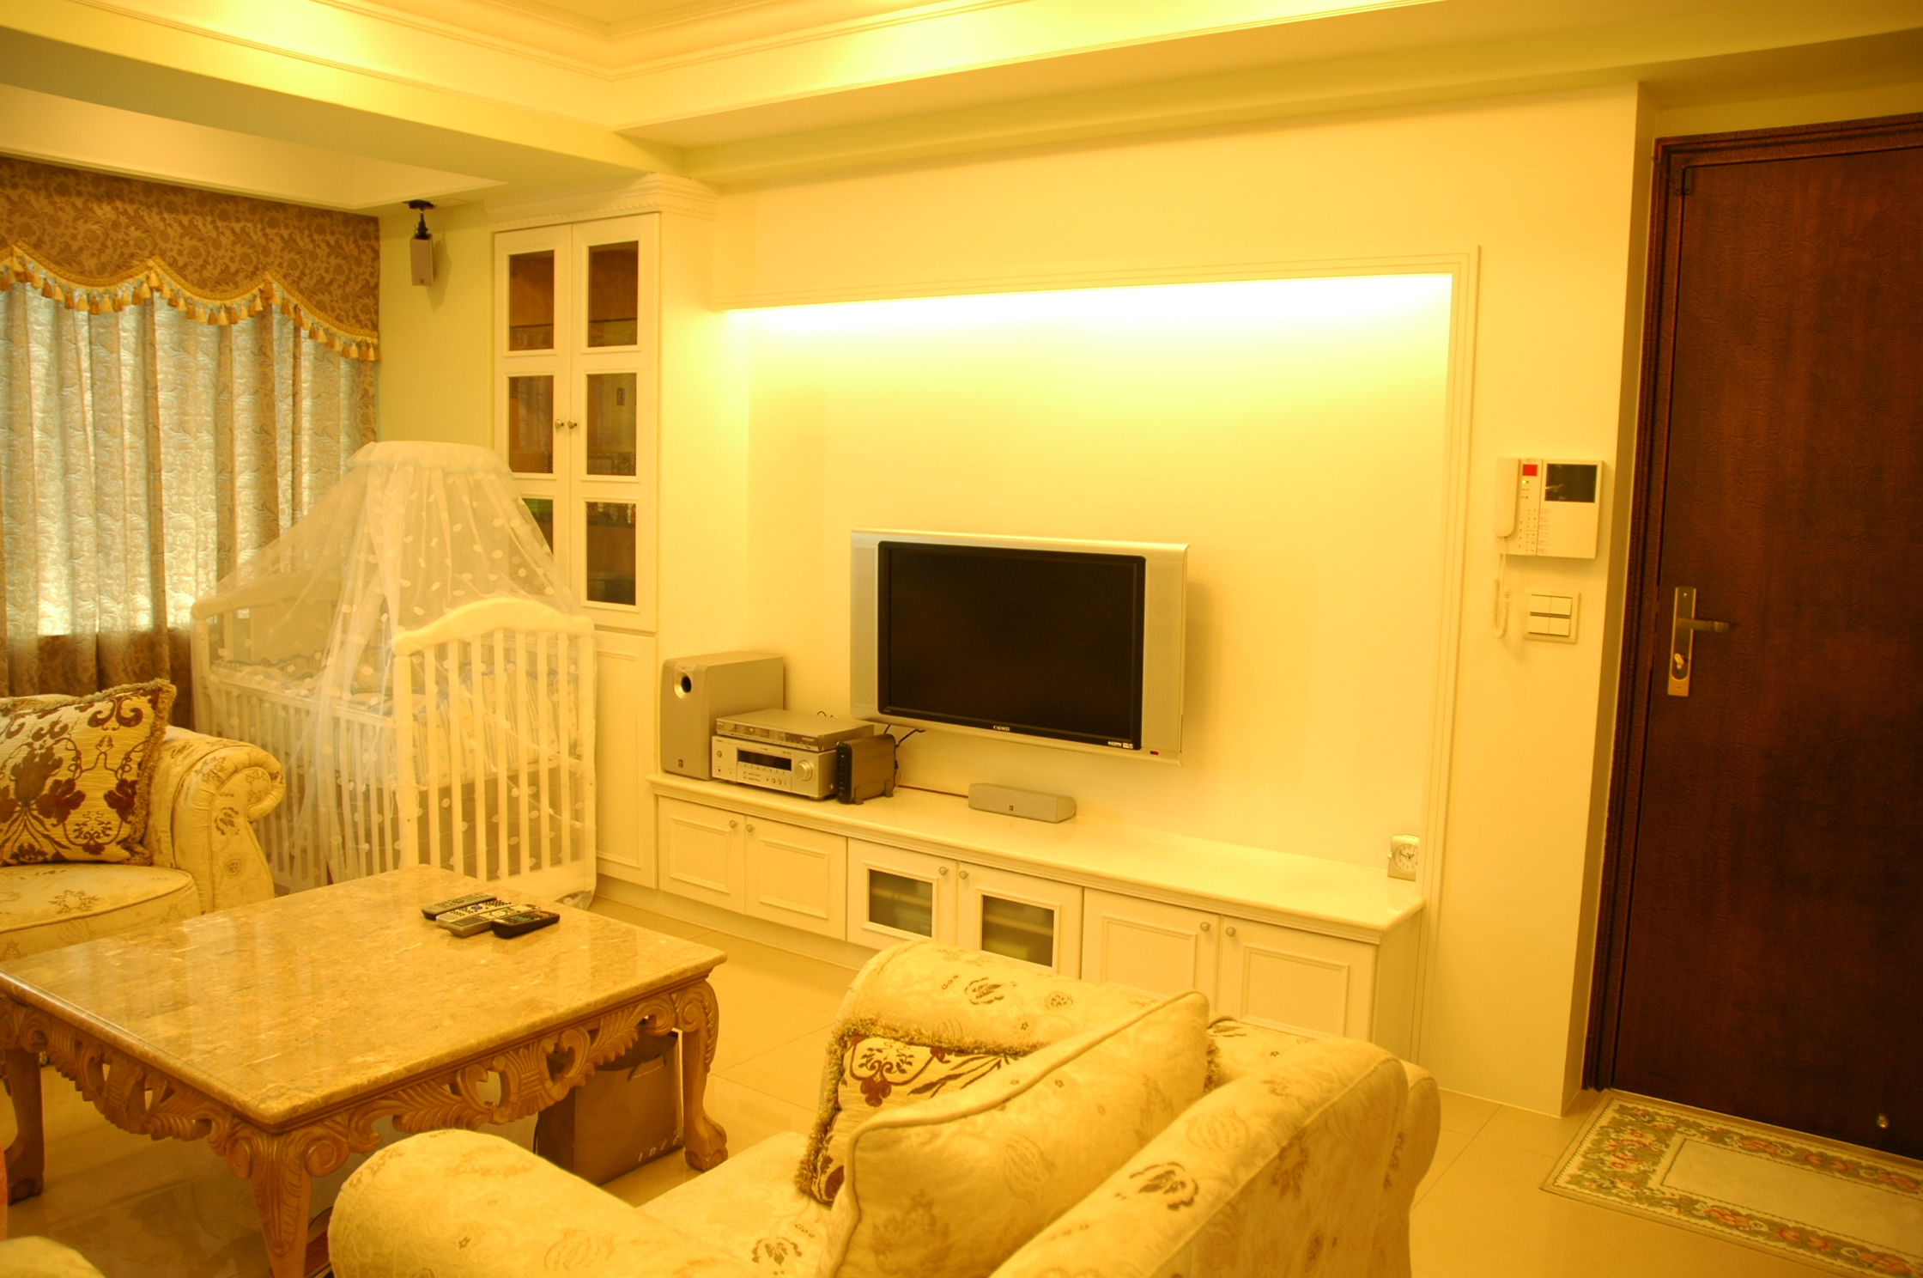
Zoom in to See Details
QNAP NVR
QVR 5.0
By right-clicking the mouse and dragging an area on the screen, that area will be enlarged with a more clear view.
Notes:
15
回放畫面縮放控制
滑鼠左鍵框選選取特定區域作縮放
滑鼠滾輪滑動作縮放控制

Slide 16
Extract Video for Export
QNAP NVR
QVR 5.0
Upload to YouTube
Save to client PC
Notes:
美化
擷取錄影畫面輸出
擷取錄影畫面:
轉存至本地端
上傳至Youtube
email傳送分享

Slide 17
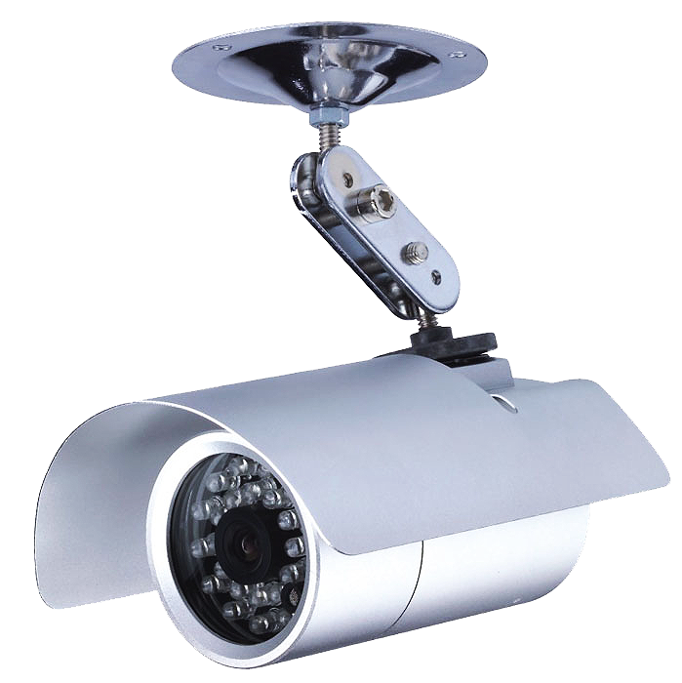
Select Recording Mode
QNAP NVR
QVR 5.0
Basic
Pro
Standard Recording
(System Configured)
Smart Recording (User Defined)
Notes:
美化

Slide 18
Smart Recording
QNAP NVR
QVR 5.0
Smart recording intelligently records standard resolution videos in regular recording, and switches to high resolution automatically when alarms are triggered. This greatly saves your cost spent on hard drives and provides you with high resolution video evidence when needed.
Low resolution video stream
High resolution video stream
Notes:
美化，用影像圖

Slide 19
Support Global Camera Brands
QNAP NVR
QVR 5.0
High quality recording
Smart recording
Notes:
Schedule for other camera brand and models

Slide 20
Mobile App
QNAP NVR
QVR 5.0

Slide 21
Vcam Turn your mobile cam as IP camera
QNAP NVR
QVR 5.0
Record to NAS/NVR
Notes:
手機和電腦圖用相同的錄像

Slide 22
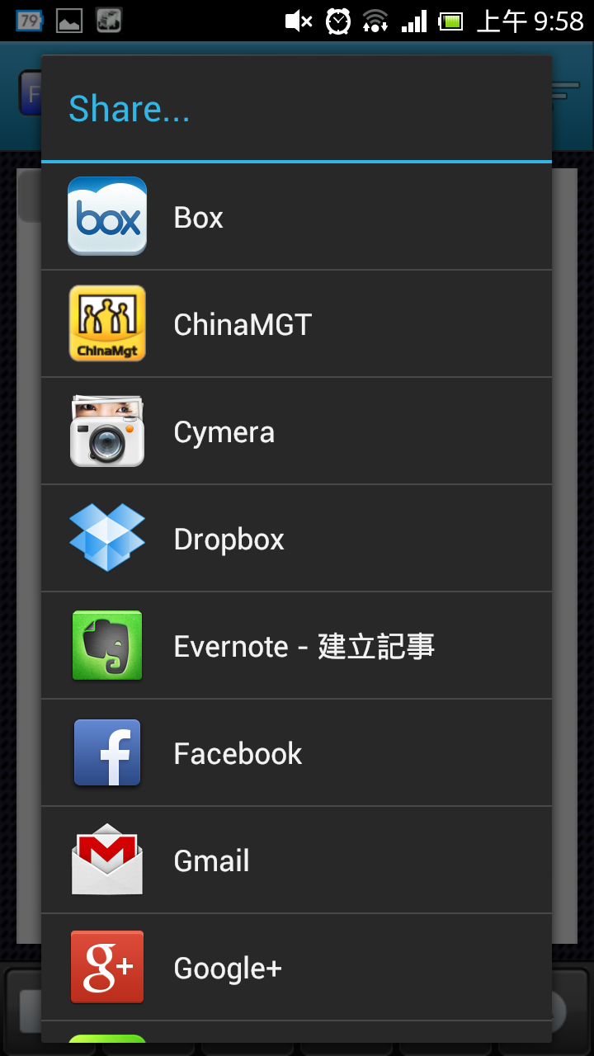
VMobile Mobile Surveillance
Live view, playback and event notifcation

Slide 23
Industrial Grade NVR

Slide 24
Outline
Mobile NVR
Outdoor NVR
One-click configuration
Feature
Applications from switch

Slide 25
Mobile NVR Target Markets
Transportation(Our target for now)
MRT/Metro
Subway/train
Public Bus/School Bus

Slide 26
Applications
Speed
Location
coordination
Central monitoring
Event notification
Alarm input/output
SSD/HDD storage
GPS
Wireless(WLAN)
Live monitoring
Alarm notification
Live monitoring
Alarm notification
Configuration
Playback
Notes:
Digital signage

Slide 27
QNAP Advantages
Provide complete and professional experiences in NVR surveillance system : the full spectrum of the Standalone turnkey NVR
Easy for installation on site
IEI know-how in mobile industrial computers
The popularity of 4G in the near future
Fast upload and download speed=> good for video/data streaming

Slide 28
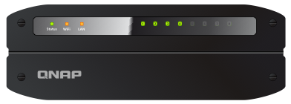
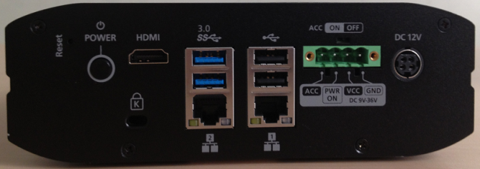
Requirements
Antishock, anti-vibration
Storage
SATA interface
Capacity (> 1TB)
Expandable
Comprehensive data protection with reliable backup (RAID)
Power
External adapter
Low power consumption (<50W)
USB UPS support
Simplified management & higher availability
Remote access
Remote monitoring
Wide operating temperature
Notes:
Performance, price, avalibility
28

Slide 29
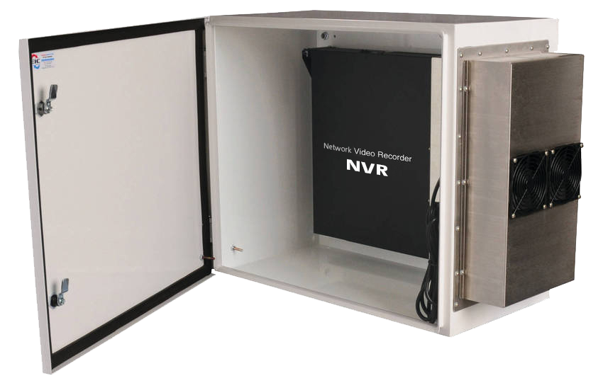
Outdoor NVR
Waterproof & dustproof (IP55 for the case)
Wide operating temperature: -20˚C~60 ˚C

Slide 30
One-click Configuration
Features:
Save time and effort in IP camera configuration.
Sophisticated yet simple to setup surveillance solution.

Slide 31
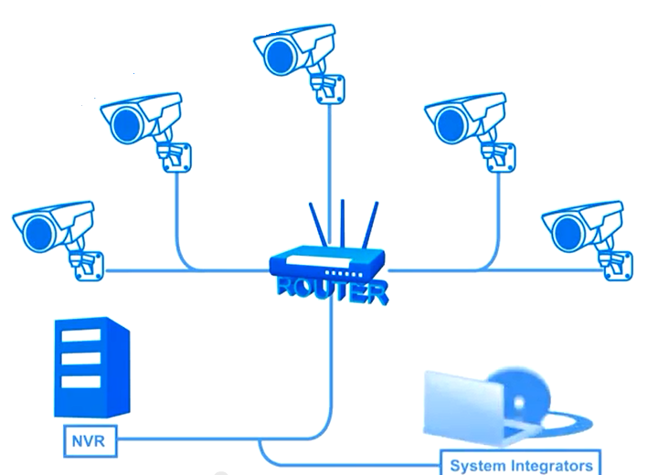
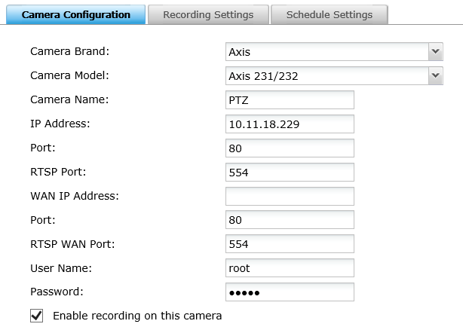
Normal
IP configuration

Slide 32
Auto IP configuration

Slide 33
Applications from Switch
Device IP for each port
Link up / link down for each port
PoE enable / PoE disable for each port
Analyze NetFlow of each port
Remaining power for each port
Build up switch’s topology

