Slide 1
QNAP Surveillance Solution
QNAP Security

Slide 2
Agenda
About QNAP Security
Why standalone NVR
What's new?
VioStor NVR is…
What’s next?
Success story

Slide 3
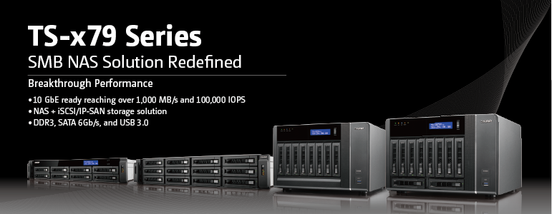
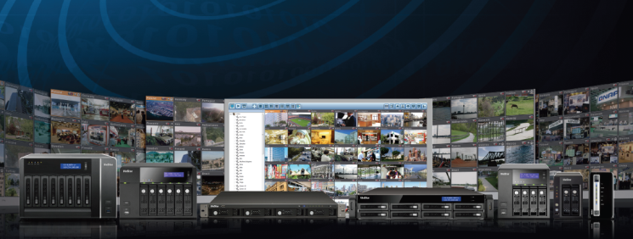
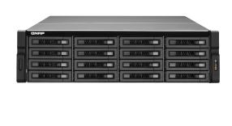
Core Technology
NAS
Network
Attached
Storage
Viostor NVR Series
NMP
Network
Multimedia Player
NVR
Network
Surveillance
System
iNDS
Digital Signage
System
Based on solid QNAP NAS, QNAP Security provides full spectrum VioStor NVR series

Slide 4
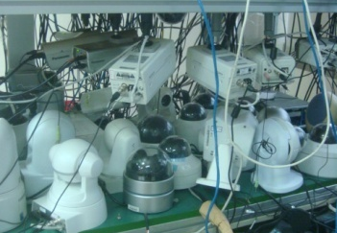
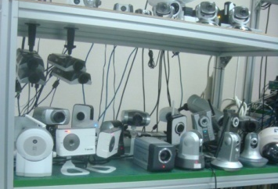
Solid Development Power
Hardware
Top notch E/E and ME design engineer team
Partner with major chipset vendors
ID/ME/Thermal in house design & simulation capability
Testing: Stress, reliability, performance, functional, compatibility, EMI...
Facility: SMT/DIP & Assembly
Software
Pioneers in embedded
Linux technology
High performance and high reliability server & video technology
Extensive experience in RISC I/O processor
Experts in TCP/IP offload engine technology
Most complete self-developed management software
Advanced network distributed management technology
Integration
Camera integration
Long-term testing
Notes:
stardot

Slide 5
QNAP Global Market Position
Gartner (March 2012)
QNAP is top 8 world storage company
Gartner (March 2011)
QNAP is the global top 3 SMB NAS brand (MSRP below $24,999)
IMS Research (2010)
QNAP is Top 10 Embedded NVRs supplier in the world
Recognition from Media around the World
Notes:
5

Slide 6
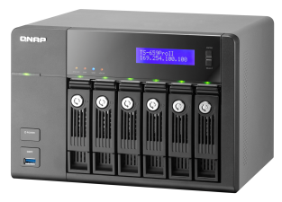
Recognition around the World
NVR Excellence Award in Secutech Awards 2013 Contest
InfoWorld's 2012 Technology of the Year Award winners
VS-4116 Pro+
TS-659 Pro II

Slide 7
Agenda
About QNAP Security
Why standalone NVR
What's new?
VioStor NVR is…
What’s next?
Success story

Slide 8
Advantages of Standalone NVR
 | Standalone NVR | PC-based Solution
OS | Linux Embedded | Windows
Stability | High | Low
Setup cost | Low | High (+ PC)
Ease of setup & management | Easy, only simple steps | Difficult (Software required)
System temperature | Low | High
Maintenance (frequency) | Low (easy-to-maintain) | High
System crash risk | Low | High
Problem analysis | Easy (by event logs) | Difficult
Auto power on when power recovery | Yes | No, manual reboot required
Virus attack/Trojan threaten | None | Sometimes
Power consumption and noise level | Low | High
Total maintenance cost | Low | High

Slide 9
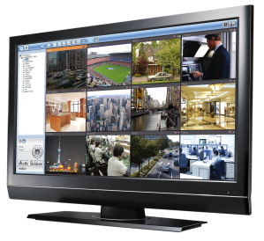
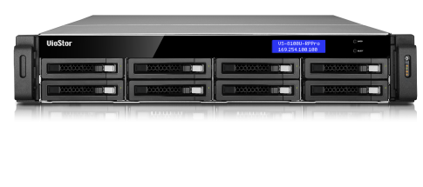
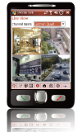
Innovative NVR Solutions
Remote Replication
Surveillance Storage Expansion
HD Local Display
Turbo NAS
Multi-site VioStor NVR
Remote Monitoring/ playback
Mobile Surveillance

Slide 10
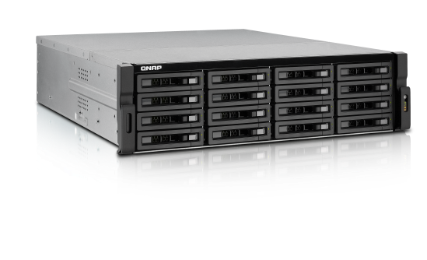
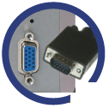
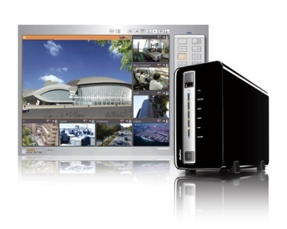
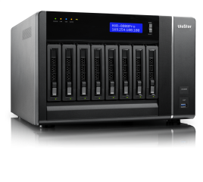
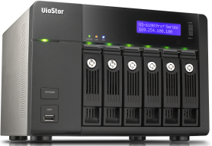
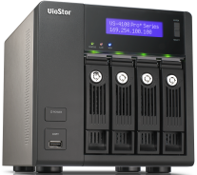
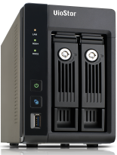
Full Spectrum NVR Series
QNAP has developed a series of Network Video Surveillance systems (VioStor NVR) which support high performance and reliable real-time monitoring and recording from network cameras.
Enterprise
Enterprise
Enterprise
Enterprise
HD Local Display
HD Local Display
HD Local Display
VS-16100U-RP Pro+ series
VS-12164/12156/12148/12140U-RP Pro+
Up to 64/56/48/40 channels
VS-8148/8140/8132/8124U-RP Pro+
Up to 48/40/32/24 channels
VS-4116/4112/4108U-RP Pro+
Up to 16/12/8 channels
Enterprise
Enterprise & SMB
Enterprise & SMB
SMB & SOHO
SOHO & Home
HD Local Display
HD Local Display
HD Local Display
HD Local Display
VS-8148/8140/8132/8124 Pro+
Up to 48/40/32/24 channels
VS-6120/6116/6112 Pro+
Up to 20/16/12 channels
VS-4116/4112/4108 Pro+
Up to 16/12/8 channels
VS-2112/2108/2104 Pro+
Up to 12/8/4 channels
VS-2108L/2104L
Up to 8/4 channels

Slide 11
Agenda
About QNAP Security
Why standalone NVR
What's new?
VioStor NVR is…
What’s next?
Success story

Slide 12
VS-12100U-RP Pro+
12-bay, 2U rackmount NVR

Slide 13
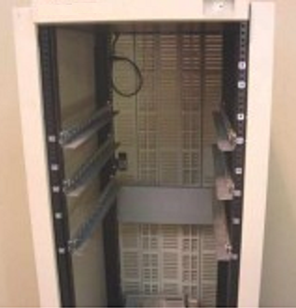
VS-12100U-RP Pro+ Introduction
VS-12100U-RP Pro+ Series
* 64ch/ 56ch/ 48ch/ 40ch
2U compact design with 12-bay HDD support
Quad-core Intel® i5 Processor and server-level hardware platform
Redundant power supply
RAID 0, 1, 5, 6, 5+hot spare, 6+hot spare
High storage capacity up to 48 TB
4 Gigabit LAN ports for optimized internet bandwidth capacity
Intelligent automatic power on after power recovery
Linux-embedded, highly reliable standalone NVR
2U
48 TB

Slide 14
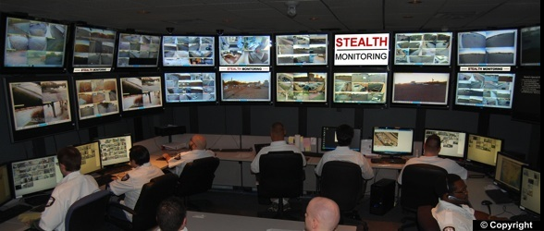
Key Features of VS-12100U-RP Pro+
450 Mbps recording throughput
Up to 64-channel H.264 + 30fps + HD recording and live view
UP to 64-channel H.264 + 15fps + Full HD recording and live view
Smart recording
Storage expansion (NVR + NAS) for long-term recording
Local display via HDMI/VGA output
Free embedded VMS
VMobile surveillance app

Slide 15
Product Specification Table
Product Specification Table
NVR Model | VS-12164/12156/12148/12140U-RP Pro+
Max. number of supported IP cameras/channels (recording) | 64/56/48/40
Video server support | Yes
High-definition local display | Yes
Multi-server monitoring | Yes (up to 128 channels)
Video compression | H.264, MPEG-4, M-JPEG & MxPEG (depending on camera models)
Max. network throughput | 450 Mbps⁽¹⁾
Megapixel recording | Yes (up to 10-megapixel)
Multi-view playback | 16-view
Intelligent video analytics on remote playback page | Motion detection, missing object, foreign object, out of focus, and camera occlusion
Real time digital watermarking | Yes
Advanced event management | Yes
Storage Expansion | Yes
Number of hard drive slots | 12
Physical storage capacity | 48TB (12 x 4TB hard drives)⁽²⁾
Hard drive interface | SATA 6Gb/s (backward compatible with SATA 3GB/s)
RAID | RAID 0, 1, 5, 5+hot spare, 6, 6+hot spare
Processor | Intel® Processor i5 3.7GHz
Number of Gigabit LAN ports | 4
Number of USB ports | USB 3.0: 2 (rear) USB 2.0: 4 (rear)
Redundant power supply | Yes
Power Consumption | 167W
Hardware dimensions | 88(H) x 439(W) x 520(D) mm 3.46(H) x 17.28(W) x 20.47(D) inch
Gross weight | 25.60 kg / 56.44 lb
(1) Based on QNAP’s laboratory tests. Actual performance may vary depending on the network environments.
(2) The standard system is shipped without hard disk drives.

Slide 16
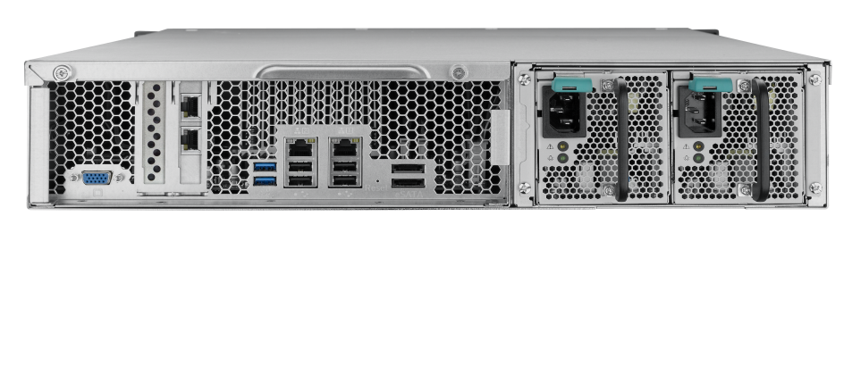
4 Gigabit LAN Ports Support
Innovative
Secure
Speed
Reliable

Slide 17
4 Gigabit LAN Ports Support
Failover: Failover allows the VioStor NVR to sustain the failure of one network port to provide continuous services. (ex: LAN1& LAN2 trunking + LAN3& LAN4 trunking)
Loading balance: Bandwidth aggregation is supported to boost the file transfer speed. 2 Gigabit LAN Ports trunking into one wider bandwidth. (works with managed Ethernet switch with 802.3ad configuration)
Multi-IP Settings: 4 IP settings can be configured on the NVR to allow network access from 4 different subnet!
Secure
Speed
Reliable

Slide 18
VioStor NVR FW v4.1.1
Features Highlight

Slide 19
NVR FW v4.1.1 Features Highlight
Surveillance storage expansion NVR + NAS for long-term recording
User defined multi-stream Configurable stream profile
Smart recording Save HDD cost and boost alarm recording
Edge recording Seamless recording
Two-way audio
Upgraded local display performance

Slide 20
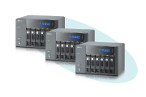
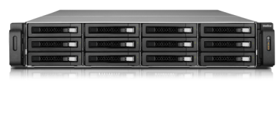
Storage Expansion Solutions
Scalable and higher efficiency
StorageExpansion App
Turbo NAS
VioStor NVR
Surveillance Storage Expansion
Applied series: QNAP VioStor Pro(+) series (FW v4.1.0 or above) and Turbo NAS x69, x79, x70 series (only FW v4.0.2)

Slide 21
Suggested Scenario
To make sure NVR CPU working well with the recording and storage expansion, we strongly suggest the following limitation of recording network throughput for specific VioStor NVR series, and CPU loading can be reserved for storage expansion.
VS-8100 Pro+/8100U-RP Pro(+)/12100U-RP Pro(+) series
Suggested limitation for recording network throughput: 360 Mbps.
VS-2100 Pro+/4100 Pro+/6100 Pro+ series
Suggested limitation of recording network throughput: 160 Mbps.
VS-2000 Pro/4000 Pro/6000 Pro series
Suggested limitation of recording network throughput: 90 Mbps.
One NVR to up to 4 NAS devices
One NVR to up to 3 NAS devices
One NVR to up to 2 NAS devices
Notes:
接幾台NAS

Slide 22
User Defined Multi-stream
Administrators can now flexibly define compression rate, resolution, fps, and quality settings for multiple video streams (supported by specific camera models) according to bandwidth resources and number of live-view channels, and then choose a proper video stream for live-view.

Slide 23
Different Recording Modes
System configured (for standard usage):
NVR System automatically select and allocate video streams from IP camera for different use.
User defined (for advance usage):
Round-the-clock recording mode
Regular and Alarm: Record at defined video stream profile.
Smart recording mode
Regular: Record normal routines in lower quality.
Alarm: Boost recording quality to include enough details for better observation.

Slide 24
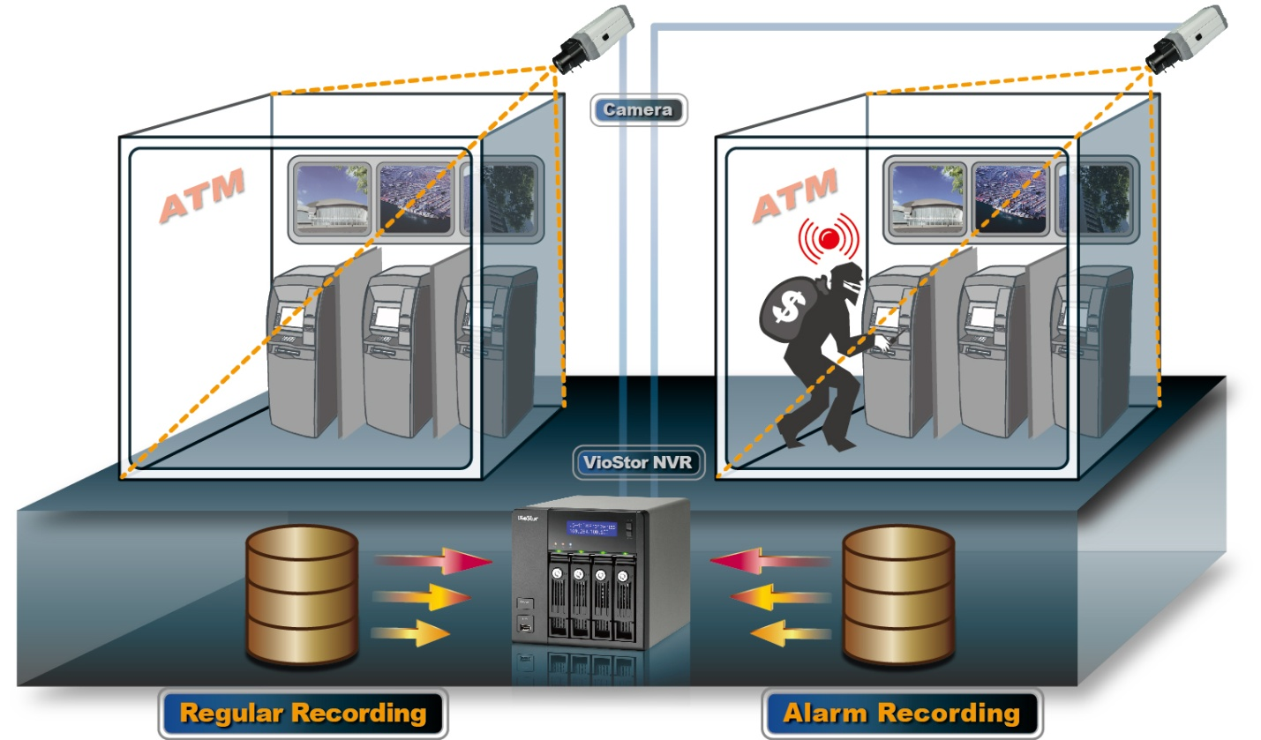
Standard Recording
Full HD 1080P recording,
H.264, 30fps, 6Mbps bit rate
Full HD 1080P recording,
H.264, 30fps, 6Mbps bit rate
Uses one/same video stream for both alarm and regular recording at same resolution and FPS at ALL times.
---> Same demand for storage space ALL the time. Little flexibility.

Slide 25
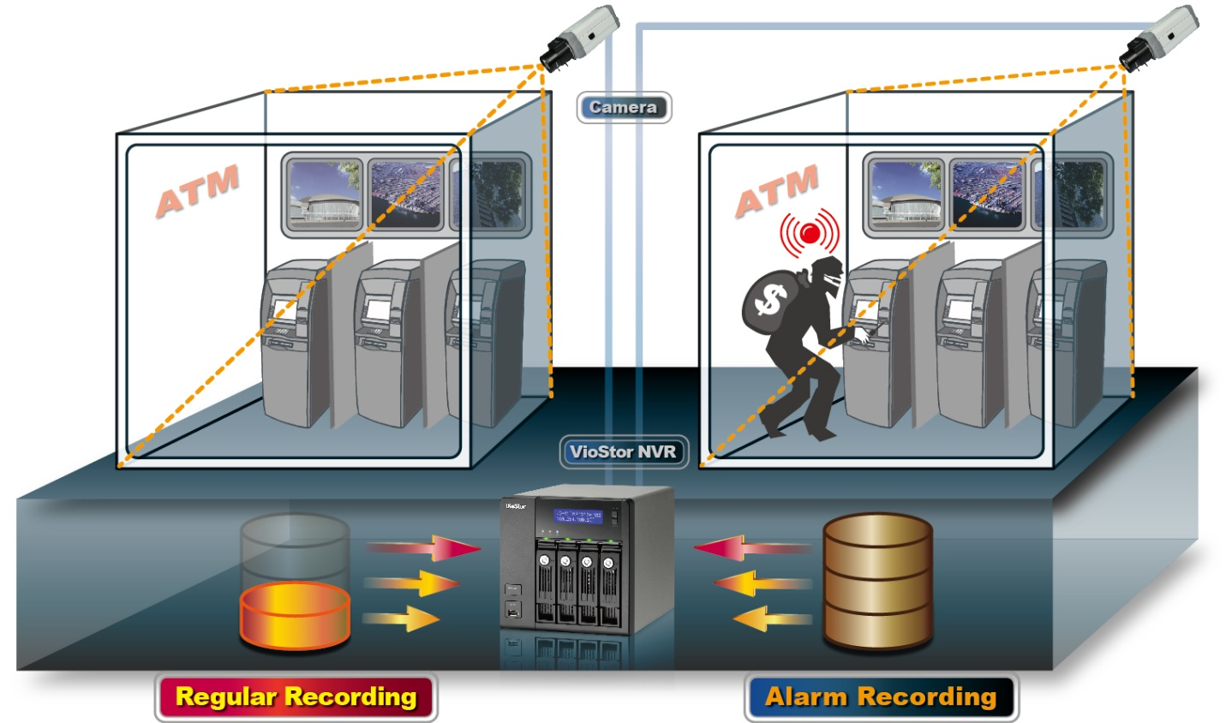
Smart Recording
Alarm Trigger
Record lower resolution video stream
Record higher resolution video stream
VGA recording,
MJPEG, 3fps, 1Mbps bit rate
Full HD 1080P recording ,
H.264, 30fps, 6Mbps bit rate
Dynamically switch to record higher resolution and FPS on alarm trigger.
Small bit rate stream for Regular Recording; high bit rate stream for Alarm Recording.
---> Higher demand for HDD storage space ONLY when an event occurs!

Slide 26
Compatible with Major Camera Brands
Standard recording
Smart recording
Notes:
Schedule for other camera brand and models

Slide 27
Edge Recording
If the camera loses connection with the NVR, the recording file is lost before without edge recording feature.
However, some network cameras supports video recording directly to an on-board SD-Card now. We can leverage recording on SD card for redundancy.
Advantage Failover recording if the camera loses connection with the NVR and then resume the connection.

Slide 28
Disconnected If No Edge Recording

Slide 29
Disconnected If Edge Recording

Slide 30
Resume the Connection

Slide 31
Two-way Audio
Two-way audio:
➔AXIS 212/ 214/ M1033/ M1034/ M1054/ P1343/ P1344/ P1346/ P1347/ P1353/ P1354/ P1355/ P1357/ P3301/ P3304/ P3346/ P3363/ P3364/ P3367/ P3384/ P5512/ P5534/ P5544/ P8221/ Q1602/ Q1604/ Q1755/ Q1902/ Q1910/ Q1921/ Q1922/ Q6032 / Q6034/ Q6035 are newly supported
➔VS-2100 Pro+/4100 Pro+/6100 Pro+ series:
Two-way audio is also supported in local display interface.
Audio in

Slide 32
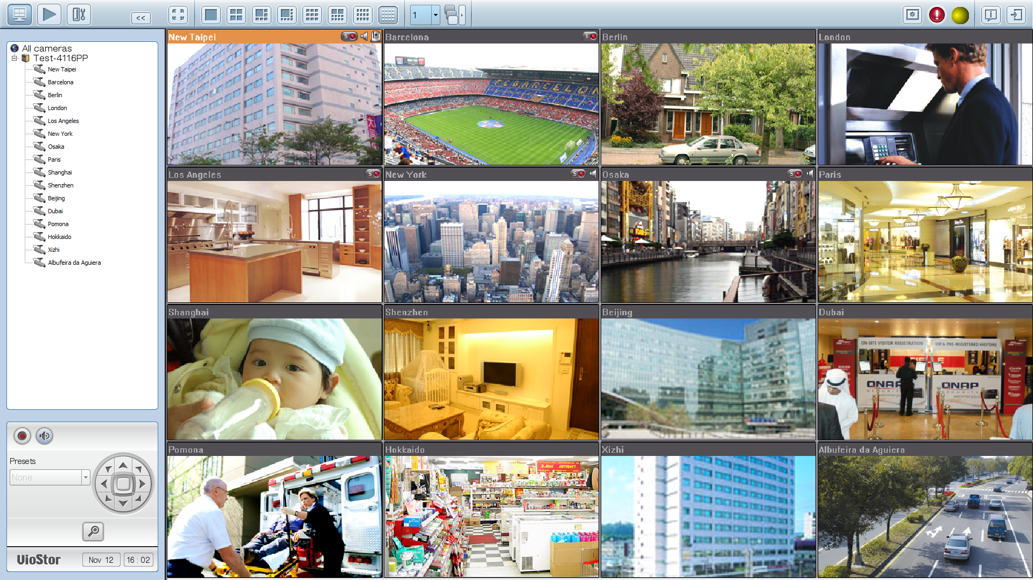
Hardware Decode Local Display
VS-8100U-RP Pro+/12100U-RP Pro+: Full HD @ 300fps
VS-8100 Pro+/8100U-RP Pro/12100U-RP Pro: Full HD @ 270fps
VS-2100 Pro+/4100 Pro+/6100 Pro+: Full HD @ 200fps

Slide 33
Agenda
About QNAP Security
Why standalone NVR
What's new?
VioStor NVR is…
What’s next?
Success story

Slide 34
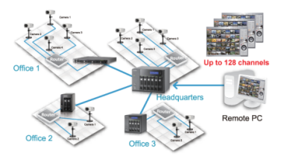
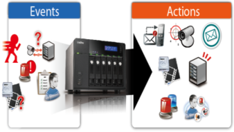
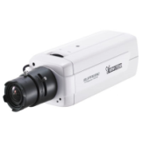
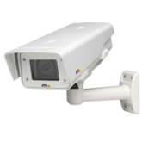
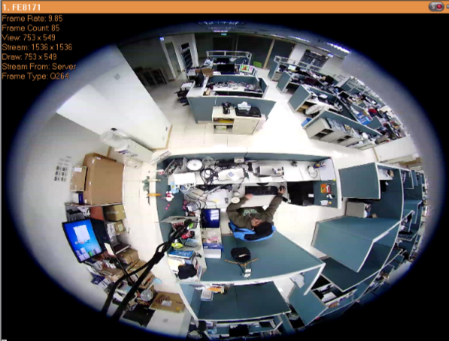
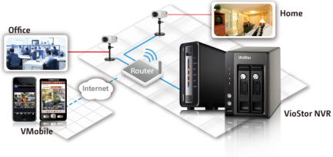
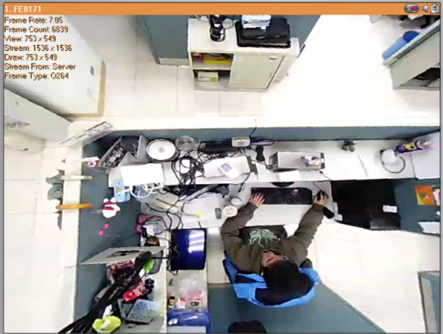
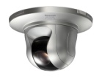
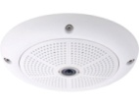
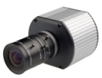
VioStor NVR is…
Compatible with a broad range of IP cameras
World’s first Linux-based NVR with HD local display (VioStor Pro(+) series)
QNAP Surveillance Client for Windows and Mac
Intelligent Video Analytics (IVA) for fast video search
Live view on mobile devices by VMobile
Green NVR solution
Advanced event management for event handling
128-channel monitoring from multiple VioStor NVR servers
Megapixel recording (up to 10-megapixel camera)
Fisheye dewarping support
Windows and Mac-compatible
Multi-server Monitoring
is a member of
HD Local Display
Event Management
Motion Detection
Foreign Object
Missing Object
Out of Focus
Camera Occlusion
Megapixel Recording
Dewarp function
IVA
Mobile Surveillance
Green NVR solution

Slide 35
Supports a Broad Range of IP Cameras
Compatible with 94 camera brands, over 2,200 camera models
is a member of

Slide 36
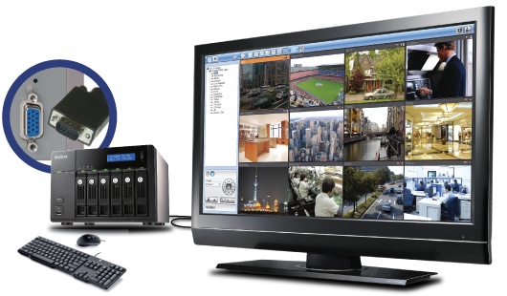
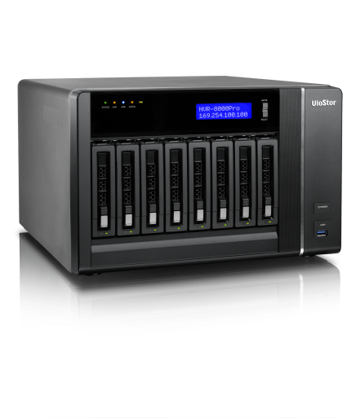
First Linux-based Standalone NVR with HD Local Display
The Linux-based standalone NVR* supports PC-less quick configuration, monitoring of IP cameras on the network, video playback and system administration by local display via a monitor, a USB mouse and a USB joystick (optional). The administrator can manage the surveillance system with the least hardware required.
VGA connector
*1 For VioStor Pro(+) series only
*2 VioStor Pro+ support HDMI local display.

Slide 37
Cross Browsers Enhancement
On Windows PC
Microsoft Internet Explorer 8/9/10 (Windows PC, desktop mode, 32-bit)
Google Chrome 24.0.1312.57 m (Windows PC)
Mozilla Firefox 18.0.2 (Windows PC)

Slide 38
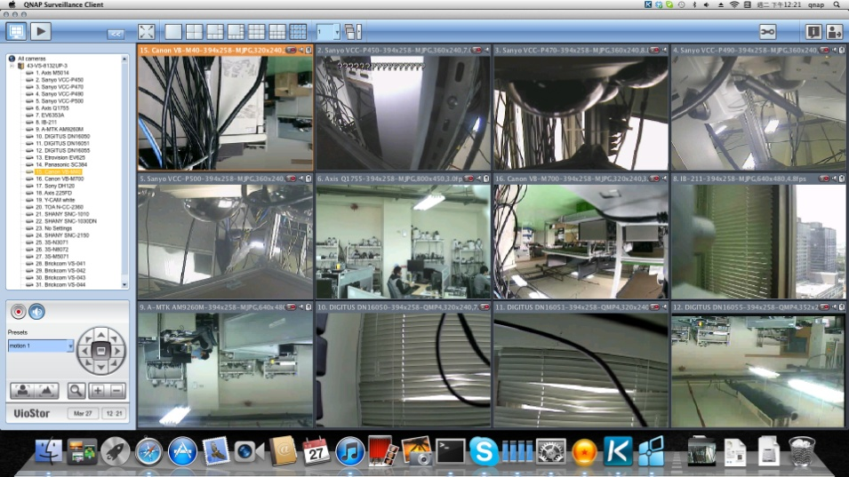
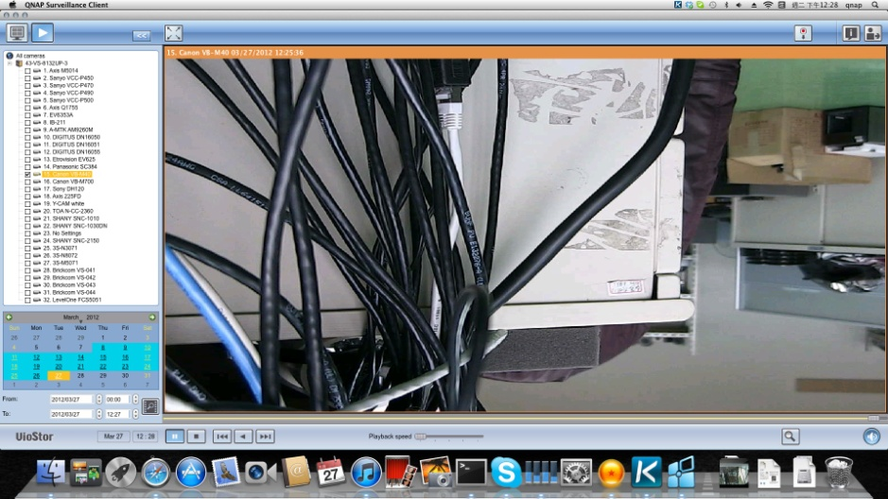
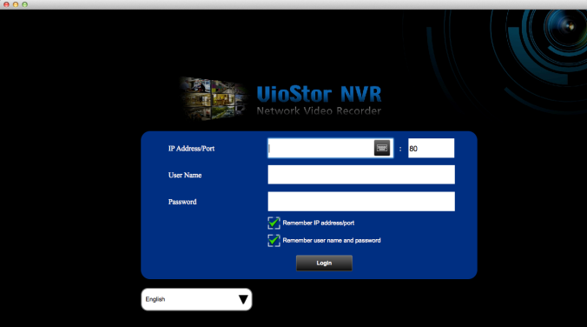
QNAP Surveillance Client for Mac
Monitoring page
Playback page
Only live view and playback are supported on QNAP Surveillance Client.
Note: To use QNAP Surveillance Client for Mac, your Mac should be running OS X 10.7.x, 10.8.x.
Mac and Mac OS are trademarks of Apple Inc., registered in the U.S. and other countries.
Notes:
PC & Mac 比較表
準備上市

Slide 39
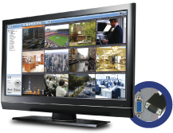
128-channel Monitoring from Multiple VioStor NVR Servers
Free embedded VMS
Up to 128 Channel
HD local display
Video Server
PC Client
IP Camera
Analog Camera
No additional software required!

Slide 40
New Remote Monitoring Interface
Intuitive monitoring interface
> New device/camera tree for clear system overview and more features
> Flexible drag & drop of control panel
Max 64-channel display mode
Notes:
彈性拖拉要秀圖
From 42 to 64 channel
秀disk error 視窗
project-option => 64 channel

Slide 41
New Remote Playback Interface
Intuitive playback interface
> New device/camera tree for clear system overview
> Flexible drag & drop of control panel
Timeline of recording status

Slide 42
Advanced Event Management for Event Handling
Events
Camera Event: Motion detection, alarm input, connection failure
NVR Event: Recording failure
Actions
External Event: User-defined event
User-defined action
SMS and email alert
PTZ camera control, alarm output
Multi-channel recording, NVR buzzer

Slide 43
Megapixel Recording
High Performance Megapixel Recording
NVR Model | Network Throughput
VS-12164U-RP/12156U-RP/12148U-RP/12140U-RP Pro+ | 450 Mbps
VS-8148U-RP/8140U-RP/8132U-RP/8124U-RP Pro+ | 400 Mbps
VS-8148/8140/8132/8124 Pro+ | 400 Mbps
VS-6120/6116/6112 Pro+ | 330 Mbps
VS-4116U-RP/4112U-RP/4108U-RP Pro+ | 250 Mbps
VS-4116/4112/4108 Pro+ | 250 Mbps
VS-2112/2108/2104 Pro+ | 180 Mbps
Software Performance
* Actual performance may vary in different environment.
VS-12100U-RP Pro+ series
Supports live view and real-time recording from maximum 64 cameras
High quality H.264, MPEG-4, M-JPEG and MxPEG recording
64-channel H.264 + 30fps + HD recording and live view
64-channel H.264 + 15fps + Full HD recording and live view

Slide 44
360° Panomorph Ready
Single PTZ window
Complete perimeter view in one window (2 x 180°)
Four PTZ view in one window
To know the camera models which can be installed with panomorph lens, please visit http://www.qnapsecurity.com/faq_detail.asp?faq_id=718.

Slide 45
Fisheye Dewarping Support
AXIS M3007
VioStor NVR supports different display mode, including overview, Panorama, Double Panorama, Quad View, View Area1, View Area2, View Area3 and View Area4.
Vivotek FE8171V/8172(V)
Dewarp function for FE8171V/8172(V) is supported on live view and playback of remote PC and local display interface.

Slide 46
Intelligent Video Analytics for Fast Video Retrieval
Tired of spending hours trying to find the recording files related to specific events? Now there’s no need to browse video files one by one by staring at the monitor looking for what you need. The VioStor NVR provides intelligent video analytics (IVA) function that enable users to retrieve what’s needed quickly.

Slide 47
Live View on Mobile Devices
VMobile is a mobile video surveillance utility provided by QNAP for users to monitor the IP cameras on the VioStor NVR. With VMobile installed on your Android phone, iPad, iPhone, iPod Touch, you can monitor your home and office and receive instant event alert anytime, anywhere.

Slide 48
Available on Android and iOS Devices
Support Android and iOS mobile devices
Channel Assignment Overview
PTZ control
Playback

Slide 49
Green NVR Solution
Green NVR solution: Embedded Linux system with low power consumption The Linux-based VioStor NVR is more power-saving and quiet, and less vulnerable to virus attacks compared to PC-based surveillance solutions.
+
+
The VioStor NVR helps you save more $$$ with lower power consumption.

Slide 50
Agenda
About QNAP Security
Why standalone NVR
What's new?
VioStor NVR is…
What’s next?
Success story

Slide 51
New NVR Features
Surveillance storage expansion

Slide 52
Agenda
About QNAP Security
Why standalone NVR
What's new?
What’s next?
VioStor NVR is…
Success story

Slide 53
Success Story - Petrol Station
Largest petroleum company in India All in all, the VS-2008 Pro earns the heart of BPCL as a turnkey solution for long-term recording and heavy megapixel recording. In the first stage of this project, BPCL deployed a total of 900 units VioStor NVR VS-2008 Pro for its petrol stations in India. Source: http://www.qnapsecurity.com/SucessStory18.asp

Slide 54
Success Story - Chain Store
Famous Chain Stores in Hokkaido, Japan Over 600 pcs VS-2008 Pro NVR have been installed in popular chain stores for local/remote monitoring and recording in Hokkaido. Source: http://www.qnapsecurity.com/SucessStory04.asp
Number of Stores in Hokkaido: 986

Slide 55
Success Story – Retail Stores
Chain Stores in Malaysia The VioStor NVR has been installed in popular chain stores for remote monitoring and recording in Malaysia.
Remote monitoring and management by IE browser
Internet
or
Intranet

Slide 56
Success Story – Sightseeing Spot
Cultural Center in Spain QNAP VS-4016U-RP NVR has been installed in La Granja Palace, one of the most important cultural centers in Spain (Segovia). The NVR has been integrated with video servers to monitor the surroundings of the Palace.
Internet
or
Intranet
Remote Monitoring/ Management by IE browser

Slide 57
Success Story – Sightseeing Spot
Resort in Portugal QNAP VS-5020 NVR has been installed in Montebel Aguieira, one of the most exclusive resorts in Portugal, together with the VIVOTEK IP7142 and SD7151, to monitor the visitors, staff, and resort surroundings through the private network of the company.
Internet
or
Intranet
Remote Monitoring/ Management by IE browser

Slide 58
Success Story – Education
Japanese Communication International School in Japan The VioStor NVR has been installed in many schools all over Japan to monitor/ playback the videos via internet. Also the CMS function is suitable the school managers to monitor and manage all the cameras. Source: http://www.qnapsecurity.com/SucessStory06.asp

Slide 59
Success Story – Large Office
Famous French Sawmill Company Bois du Dauphiné put in place 20 VIVOTEK IP cameras to cover the sawmill. Coupled with QNAP VS-5020’s support for megapixel resolution, these cameras clearly display their respective views in great detail. Source: http://www.qnapsecurity.com/SucessStory07.asp

Slide 60
Success Story – Large Office
Production & Assembling Plant in Mexico QNAP VS-8024 NVR has been installed in one of the assembling plants of MAHLE in Mexico to monitor and record the visitors, staff, and the production process through the private network of the company. The MAHLE Group is one of the 30 largest companies in the automotive supply industry worldwide. Its offices locate in Europe, North America, South America, and Asia/Pacific.
Internet
or
Intranet
Remote Monitoring/ Management by IE browser

Slide 61
Success Story – Supermarket & Shopping Centre
The Largest Multi-functional Shopping Center in Taiwan Dream Mall selected QNAP NVR solutions for security system deployment. Multiple QNAP NVR servers are set up and attached to the network to monitor 600 Panasonic IP and analog cameras, using megapixel resolution and VGA resolution. Source: http://www.qnapsecurity.com/SucessStory01.asp

